Slide 1
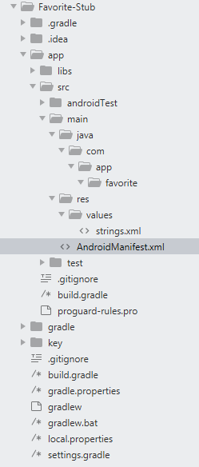
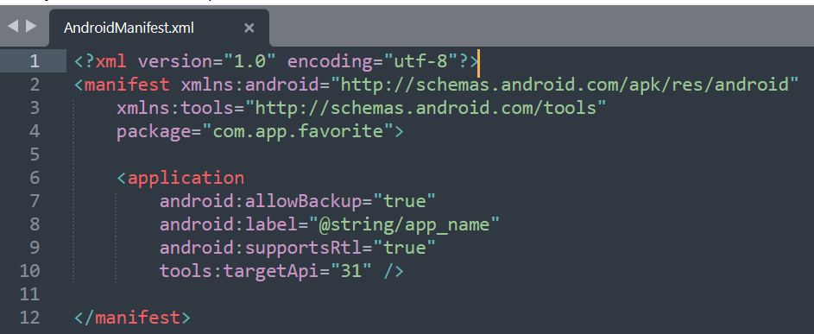
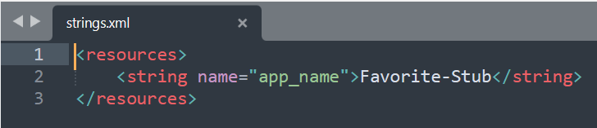
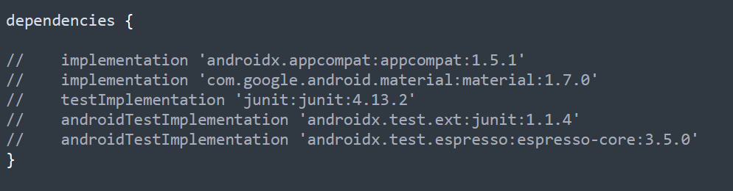
Prepare two apks
- XXX.apk
- XXX-Stub.apk
2. XXX.apk is original apk, and the XXX-Stub.apk is stub apk
3. Structure of XXX-Stub.apk in AndroidStudio

Slide 2
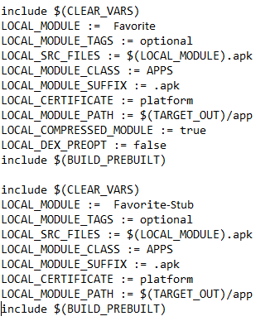
4. Modify Android.mk and add two line in original apk
5. In out folder, xxx.apk.gz will be generated as compressed APK

