Slide 1
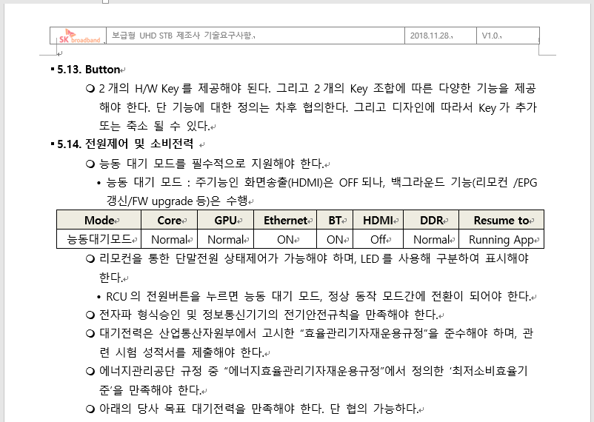
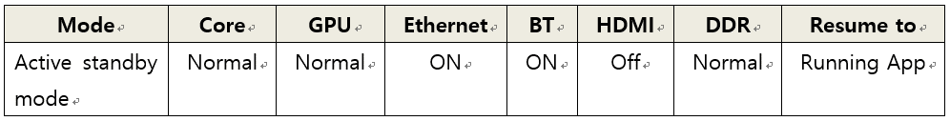
SKB Requirement for Active Standby Mode
5.14. Power control and power consumption
○ Active standby mode must be supported
· Active standby mode: the main function(HDMI) is turned off,
but the background function is on
(remote control /EPG update/ FW upgrade, etc.)

