Slide 1
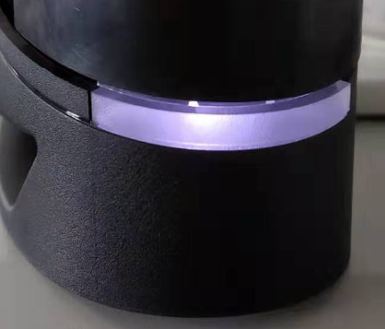
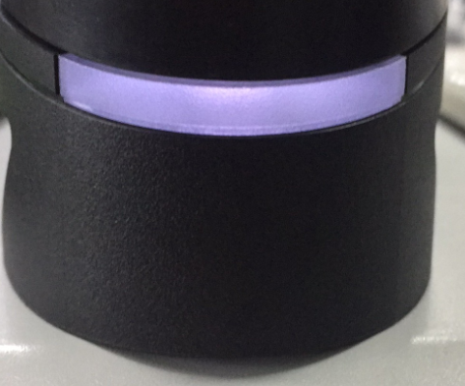
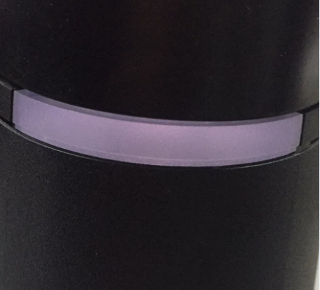
Difference glowing effect in difference content of TiO₂
Clear light ring
0.005g/kg light ring
0.01g/kg light ring

