Slide 1
Information
# Bluetooth Specification
None
Standard : Bluetooth 4.2
Band : 2.4G
Channel : 0~ 78(Classic), 0 ~39ch(BLE)
Support BR/EDR/BLE
Profile : A2DP, HID
Classic txPower : 6dBm
BLE txPower : 6dBm
None
# Feed back results of table to XXX ( Initialize Tx Power )
 | Classic |  |  |  |  |  | BLE
 | 0 | 39 | 79 |  |  |  | 0 | 19 | 39
Power Level | 6dBm | 6dBm | 6dBm |  |  |  | 6dBm | 6dBm | 6dBm

Slide 2
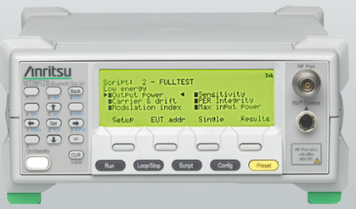
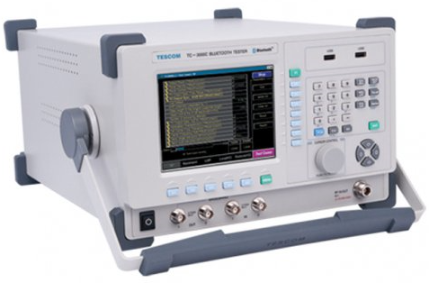

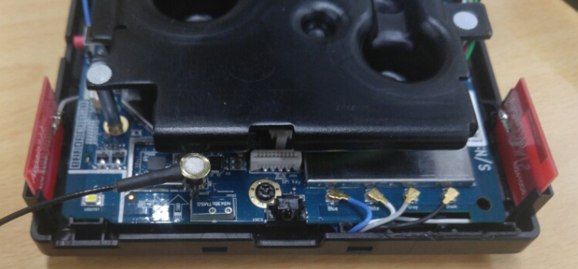
Block diagram
Block diagram
SerialCom
GPIB
For testing BLE
SerialCom
For testing BT Classic

Slide 3
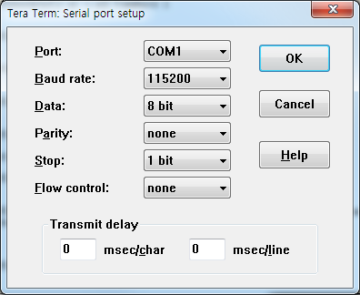
Load BT driver for test
Serial Console Setting
<<<<<<< Log >>>>>>>>
DI >
DI >sh
# cd /tmp
# insmod /lib/modules/4.1.39/kernel/drivers/bluetooth/btusb.ko
# insmod /lib/modules/4.1.39/kernel/drivers/bluetooth/bthid.ko
# bsa_server -d /dev/btusb0 -u /tmp/ -p /lib/firmware/brcm/BCM20704A2_001.002.011.0138.0144.hcd -all=0 &
# killall bsa_server
………………………………………………………………..
# udhcpc –i eth0 &
Run command on DUT after booting
Turn Wi-Fi device off like test-PC, Mobile and etc.
Turn power off DUT
Connect Serial Port
Turn power on DUT
test Bluetooth
Command List
sh
cd /tmp
insmod /lib/modules/4.1.39/kernel/drivers/bluetooth/btusb.ko
insmod /lib/modules/4.1.39/kernel/drivers/bluetooth/bthid.ko
bsa_server -d /dev/btusb0 -u /tmp/ -p /lib/firmware/brcm/BCM20704A2_001.002.011.0138.0144.hcd -all=0 &
killall bsa_server
udhcpc –i eth0 &

Slide 4
인증용 CMD – Tx / Rx
#Command List for BT Classic
# cd /tmp
# insmod /lib/modules/4.1.39/kernel/drivers/bluetooth/btusb.ko
# insmod /lib/modules/4.1.39/kernel/drivers/bluetooth/bthid.ko
# bsa_server -d /dev/btusb0 -u /tmp/ -p /lib/firmware/brcm/BCM20704A2_001.002.011.0138.0144.hcd -all=0 &
# killall bsa_server
  #Set Tx power
  None
  #Set tx Frequency(0ch, 39ch, 78ch) , PRBS Pattern, ACL_Basic,Data-Rate(DM1), 6dBm
  hcicmd 03 0003
  hcicmd 3F 0051 06 05 04 03 02 01 01 00 04 01 03 FF FF 80 06 00
  hcicmd 03 0003
  hcicmd 3F 0051 06 05 04 03 02 01 01 27 04 01 03 FF FF 80 06 00
  hcicmd 03 0003
  hcicmd 3F 0051 06 05 04 03 02 01 01 4E 04 01 03 FF FF 80 06 00
  #Set Rx Frequency(0ch, 39ch, 78ch) , PRBS Pattern, ACL_Basic,Data-Rate(DM1)
  hcicmd 03 0003
  hcicmd 3F 0052 06 05 04 03 02 01 E8 03 00 04 01 03 FF FF
  hcicmd 03 0003
  hcicmd 3F 0052 06 05 04 03 02 01 E8 03 27 04 01 03 FF FF
  hcicmd 03 0003
  hcicmd 3F 0052 06 05 04 03 02 01 E8 03 4E 04 01 03 FF FF
  #Stop
  hcicmd 08 001F
  hcicmd 03 0003
#Command List for BLE
# cd /tmp
# insmod /lib/modules/4.1.39/kernel/drivers/bluetooth/btusb.ko
# insmod /lib/modules/4.1.39/kernel/drivers/bluetooth/bthid.ko
# bsa_server -d /dev/btusb0 -u /tmp/ -p /lib/firmware/brcm/BCM20704A2_001.002.011.0138.0144.hcd -all=0 &
# killall bsa_server
  #Set Tx power
  None
  #Set tx Frequency(0ch, 19ch, 39ch) , Data-Rate(DM1), PRBS Pattern
  hcicmd 03 0003
hcicmd 08 001E 00 25 00
  hcicmd 03 0003
hcicmd 08 001E 13 25 00
  hcicmd 03 0003
hcicmd 08 001E 27 25 00
  #Set Rx Frequency(0ch, 13ch, 39ch) and Data-Rate(DM1)
  hcicmd 03 0003
hcicmd 08 001D 00
  hcicmd 03 0003
hcicmd 08 001D 13
  hcicmd 03 0003
hcicmd 08 001D 27
  #Stop
  hcicmd 08 001F
  hcicmd 03 0003

Slide 5
Test Mode – Classic
Load BT driver
Channel | PP | PP
0 | 00 | 00 | Classic
39 | 27 | 27 | Classic
78 | 4E | 4E | Classic
0 | 00 |  | BLE
19 | 13 |  | BLE
39 | 27 |  | BLE
# cd /tmp
# insmod /lib/modules/4.1.39/kernel/drivers/bluetooth/btusb.ko
# insmod /lib/modules/4.1.39/kernel/drivers/bluetooth/bthid.ko
# bsa_server -d /dev/btusb0 -u /tmp/ -p /lib/firmware/brcm/BCM20704A2_001.002.011.0138.0144.hcd -all=0 &
# killall bsa_server
Entry Bluetooth Test mode
  hcicmd 03 0003
  hcicmd 03 0005 02 00 02
  hcicmd 03 001A 03
  hcicmd 06 0003
(Hex) | RR | S1 S2 | Data length[Byte]
DM1 | 03 |  | 17
DM3 | 0A |  | 121
DM5 | 0E |  | 224
DH1 | 04 |  | 27
DH3 | 0B |  | 183
DH5 | 0F |  | 339
2-DH1 | 04 |  | 54
2-DH3 | 0A |  | 367
2-DH5 | 0E |  | 679
3-DH1 | 08 |  | 83
3-DH3 | 0B |  | 552
3-DH5 | 0F |  | 1021
Tx continuous – Single Frequency
  hcicmd 03 0003
  hcicmd 3F 0051 06 05 04 03 02 01 01 PP MM 00 RR FF FF 08 06 00
Tx continuous – Hopping Frequency
  hcicmd 03 0003
  hcicmd 3F 0051 06 05 04 03 02 01 00 PP MM 00 RR FF FF 00 00 00
Rx continuous
  hcicmd 03 0003
  hcicmd 3F 0052 06 05 04 03 02 01 E8 03 PP MM 00 RR FF FF
Tx Pattern(MM) | byte
Pseudo Random Bit Sequence 9 (Default) | 0x04
11110000 pattern | 0x09
1010 pattern | 0x03
1111 pattern | 0x02
0000 pattern | 0x01
Test Stop
  hcicmd 03 0C 00

Slide 6
Test Mode – BLE
Load BT driver
Channel | PP | PP
0 | 00 | 00 | Classic
39 | 27 | 27 | Classic
78 | 4E | 4E | Classic
0 | 00 |  | BLE
19 | 13 |  | BLE
39 | 27 |  | BLE
# cd /tmp
# insmod /lib/modules/4.1.39/kernel/drivers/bluetooth/btusb.ko
# insmod /lib/modules/4.1.39/kernel/drivers/bluetooth/bthid.ko
# bsa_server -d /dev/btusb0 -u /tmp/ -p /lib/firmware/brcm/BCM20704A2_001.002.011.0138.0144.hcd -all=0 &
# killall bsa_server
Entry Bluetooth Test mode
  hcicmd 03 0003
  hcicmd 03 0005 02 00 02
  hcicmd 03 001A 03
  hcicmd 06 0003
(Hex) | RR | S1 S2 | Data length[Byte]
DM1 | 03 |  | 17
DM3 | 0A |  | 121
DM5 | 0E |  | 224
DH1 | 04 |  | 27
DH3 | 0B |  | 183
DH5 | 0F |  | 339
2-DH1 | 04 |  | 54
2-DH3 | 0A |  | 367
2-DH5 | 0E |  | 679
3-DH1 | 08 |  | 83
3-DH3 | 0B |  | 552
3-DH5 | 0F |  | 1021
Tx continuous – Single Frequency
  hcicmd 03 0003
hcicmd 08 001E PP 25 MM
Tx continuous – Hopping Frequency
Not Supported
Rx continuous
  hcicmd 03 0003
hcicmd 08 001D PP
Tx Pattern( MM ) | byte
Pseudo Random Bit Sequence 9 (Default) | 0x00
11110000 pattern | 0x01
1010 pattern | 0x02
1111 pattern | 0x04
0000 pattern | 0x05
Test Stop
  hcicmd 08 001F
  hcicmd 03 0003

Slide 7
Classic(BR/EDR) CMD Description

Slide 8
Entry Bluetooth Test mode
o Download .hcd to BCMXXXXX
# hciconfig hci0 up
Command Sequence | hcicmd <ogf> <ocf> [parameters]
Reset | hcicmd 03 0003
Set Event Filter | hcicmd 03 0005 02 00 02
Write Scan Enable | hcicmd 03 001A 03
Enable Test Mode | hcicmd 06 0003

Slide 9
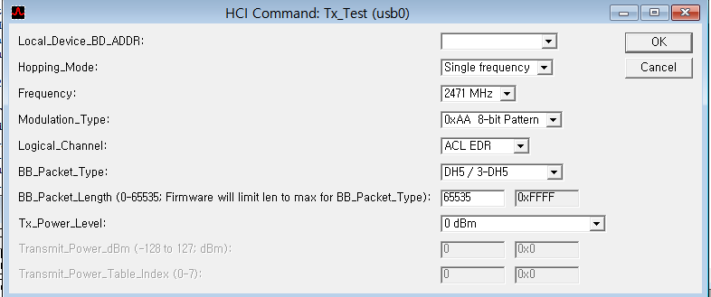

Tx Test
Tx Test Sequence
1) Test Equipment is ready to receive packet from DUT
2) DUT starts to transmit packet
hcicmd 3F 0051 <BD_ADDR> <Hopping Mode> <Frequency> <Modulation Type> <Logical channel> <BB Packet Type> <BB Packet Length> <Tx Power level> <Transmit Power dBm> <Transmit Power Table Index>
[51 FC 10]: 06 05 04 03 02 01 01 45 03 00 0F FF FF 00 00 00
opcode = 0xFC51 (64593, "Tx_Test")
Local_Device_BD_ADDR = "010203040506"
Hopping_Mode = 0x1 (1, "Single frequency")
Frequency = 0x45 (69, "2471 MHz")
Modulation_Type = 0x3 (3, "0xAA 8-bit Pattern")
Logical_Channel = 0x0 (0, "ACL EDR")
BB_Packet_Type = 0xF (15, "DH5 / 3-DH5")
BB_Packet_Length = 0xFFFF (65535, Firmware will limit len to max for BB_Packet_Type)
Tx_Power_Level = 0x0 (0, "0 dBm")
9

Slide 10
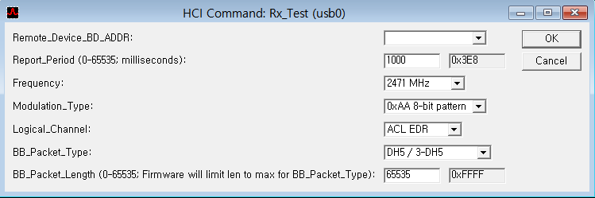
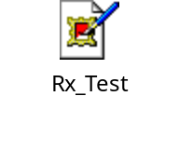
Rx Test
Rx Test Sequence
1) Request DUT to receive packet
hcicmd 3F 0052 <Remote BD_ADDR> <Report Period> <Frequency> <Modulation Type> <Logical channel> <BB Packet Type> <BB Packet Length>
[52 FC 0E]: 06 05 04 03 02 01 E8 03 45 03 00 0F FF FF
opcode = 0xFC52 (64594, "Rx_Test")
Remote_Device_BD_ADDR = "010203040506"
Report_Period = 0x3E8 (1000, milliseconds)
Frequency = 0x45 (69, "2471 MHz")
Modulation_Type = 0x3 (3, "0xAA 8-bit pattern")
Logical_Channel = 0x0 (0, "ACL EDR")
BB_Packet_Type = 0xF (15, "DH5 / 3-DH5")
BB_Packet_Length = 0xFFFF (65535, Firmware will limit len to max for BB_Packet_Type)

Slide 11
BLE CMD Description

Slide 12
Entry Bluetooth Test mode
o Download .hcd to BCM20704
# hciconfig hci0 up
Command Sequence | hcicmd <ogf> <ocf> [parameters]
Reset | hcicmd 03 0003
Set Event Filter | hcicmd 03 0005 02 00 02
Write Scan Enable | hcicmd 03 001A 03
Enable Test Mode | hcicmd 06 0003

Slide 13
Set Tx Power Level
None

Slide 14
Tx Test
BLE Tx Test Sequence
Patten
1) Test Equipment is ready to receive packet from DUT
2) DUT starts to transmit packet
hcicmd 03 0003
hcicmd 08 001E PP 25 MM
PP: BLE Tx Channel (Range: 0x00 ~ 0x27)
MM: Tx Pattern
3) Stop DUT
hcicmd 08 001F
4) Reset DUT
hcicmd 03 0003
0000 pattern | 0x01
1111 pattern | 0x02
1010 pattern | 0x03
Pseudo Random Bit Sequence 9 (Default) | 0x04
11110000 pattern | 0x09

Slide 15
Tx Test - Examples
  Examples
1) Test Equipment is ready to receive packet from DUT
2) DUT starts to transmit
hcicmd 03 0003
  >>> HCI Tx Buffer:
  >>> 0x00000000 : 01 03 0C 00
  <<< HCI Rx buffer:
  <<< 0x00000000 : 04 0E 04 01 03 0C 00
hcicmd 08 001E 00 25 00
  >>> HCI Tx Buffer:
  >>> 0x00000000 : 01 1E 20 03 00 25 00
  <<< HCI Rx buffer:
  <<< 0x00000000 : 04 0E 04 01 1E 20 00
3) Stop DUT
hcicmd 08 001F
  >>> HCI Tx Buffer:
  >>> 0x00000000 : 01 1F 20 00
  <<< HCI Rx buffer:
  <<< 0x00000000 : 04 0E 06 01 1F 20 00 00 00
4) Reset DUT
hcicmd 03 0003
  >>> HCI Tx Buffer:
  >>> 0x00000000 : 01 03 0C 00
  <<< HCI Rx buffer:
  <<< 0x00000000 : 04 0E 04 01 03 0C 00

Slide 16
Rx Test
BLE Rx Test Sequence
1) Test Equipment is ready to transmit packet from DUT
2) Test Equipment is starts to transmit DM1 packet with length 17 bytes
hcicmd 08 001D PP
PP: BLE Rx Channel (Range: 0x00 ~ 0x27)
3) Stop DUT
hcicmd 08 001F
  >>> HCI Tx Buffer:
  >>> 0x00000000 : 01 1F 20 00
  <<< HCI Rx buffer:
  <<< 0x00000000 : 04 0E 06 01 1F 20 00 R1 R2
  0xR2R1: Total Received Packet
4) Reset DUT
hcicmd 03 0003

Slide 17
Rx Test - Examples
  Examples
1) Test Equipment is ready to transmit packet from DUT
2) Test Equipment is starts to transmit DM1 packet with length 17 bytes
hcicmd 08 001D 00
  >>> HCI Tx Buffer:
  >>> 0x00000000 : 01 1D 20 01 00
  <<< HCI Rx buffer:
  <<< 0x00000000 : 04 0E 04 01 1D 20 00
3) Stop DUT
hcicmd 08 001F
  >>> HCI Tx Buffer:
  >>> 0x00000000 : 01 1F 20 00
  <<< HCI Rx buffer:
  <<< 0x00000000 : 04 0E 06 01 1F 20 00 00 00
4) Reset DUT
hcicmd 03 0003
  < HCI Command: ogf 0x03, ocf 0x0003, plen 0
  [28251.840673] btmtk_usb_send_frame : got command : 0x03 0c 00 (HCI_RESET)
  [28251.851197] btmtk_usb_send_frame : exit reject_all_cmd state
  [28252.144393] btmtk_usb_intr_complete : got event : 0x0E 04 01 03 0C 00
  > HCI Event: 0x0e plen 4
  01 03 0C 00

Slide 18
Bluetooth Pattern/Packet Parameter
Patten
Packet Type
Channel
0000 pattern | 0x01
1111 pattern | 0x02
1010 pattern | 0x03
Pseudo Random Bit Sequence 9 (Default) | 0x04
11110000 pattern | 0x09
NULL | 0x00
POLL | 0x01
FHS | 0x02
DM1 | 0x03
DH1 | 0x04
HV1 | 0x05
HV2 | 0x06
HV3 | 0x07
DV | 0x08
AUX | 0x09
DM3 | 0x0A
DH3 | 0x0B
DM5 | 0x0E
DH5 | 0x0F
EV3 | 0x07
EV4 | 0x0C
EV5 | 0x0D
2-DH1 | 0x04
2-EV3 | 0x06
2-DH3 | 0x0A
2-EV5 | 0x0C
2-DH5 | 0x0E
3-EV3 | 0x07
3-DH1 | 0x08
3-DH3 | 0x0B
3-EV5 | 0x0D
3-DH5 | 0x0F
Channel | PP | PP
0 | 00 | 00 | Classic
39 | 27 | 27 | Classic
78 | 4E | 4E | Classic
0 | 00 |  | BLE
19 | 13 |  | BLE
39 | 27 |  | BLE
Packet Type & Data Length
(Hex) | RR | S1 S2 | Data length[Byte]
DM1 | 03 |  | 17
DM3 | 0A |  | 121
DM5 | 0E |  | 224
DH1 | 04 |  | 27
DH3 | 0B |  | 183
DH5 | 0F |  | 339
2-DH1 | 04 |  | 54
2-DH3 | 0A |  | 367
2-DH5 | 0E |  | 679
3-DH1 | 08 |  | 83
3-DH3 | 0B |  | 552
3-DH5 | 0F |  | 1021

Slide 19
Link Bluetooth Devices

Slide 20
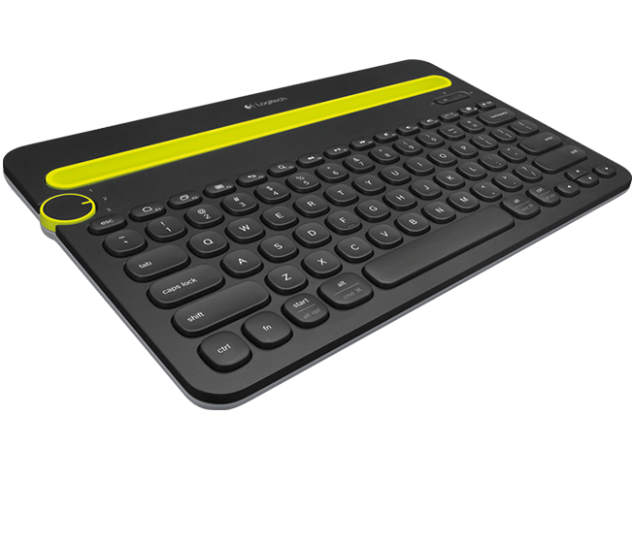
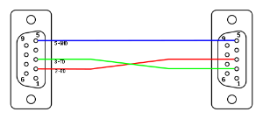



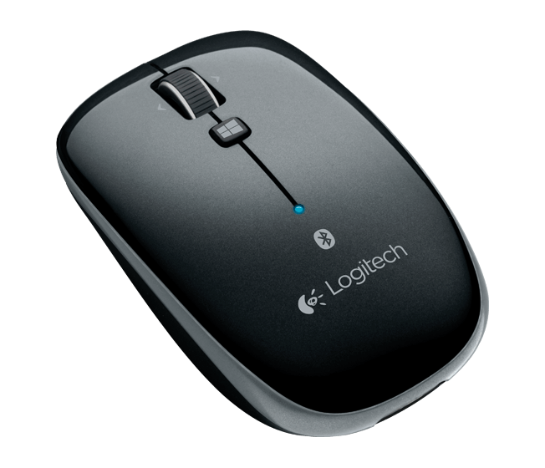
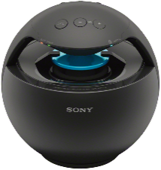
Pairing Device - Block diagram
Block diagram
Keyboard
Serial
UART
LAN
IPAddress: 192.168.1.2
IPAddress: 192.168.1.3 ( DUT IP)
Mouse
Speaker

