Slide 1


FIT
Introduction
FIT Hon Teng Limited
鴻騰六零八八精密科技股份有限公司
0610 2025
© All rights reserved by FIT Hon Teng Limited. Storage, reproduction, printing, distribution or disclosure to any third party is strictly prohibited.

Slide 2
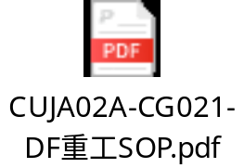
Characterize | Issue: HDMI Cable Function NG | Issue: HDMI cable function NG
 | Inspected Date: 2025.4.1 | Description: 检验批次：（2025年3月到货30,000件）Inspection lot : 30k delivered on 2025.03 抽样数量：AQL 0.15（检验1,000件）Sampling size : AQL 0.15 (1000pcs) 检验日期：2025年3月12日~2025年3月18日 Date : 2025.03.12 ~ 2025.03.18 检验地点：韩国 South Korea 问题点：2pcs功能不良，1pcs外观不良。Defects identified: 2pcs functional NG 1pcs cosmetic NG
 | Champion: ME: Lan Wen Qiang QE: Ding Jin Hua QA： Xie Zhi Hua PE：Jiang Jin Ping AssY: Xie Guo Juan PT： Cheng Ru Ying
Contain | Containment: 1 廠內無庫存 No stock available in-house 2 無在途品 No goods in transit 3 越南仓库库存60K，安排重工处理，重工SOP见附件 Current Vietnam warehouse stock: 60,000 units requiring rework. The rework standard operating procedure (SOP) is attached for reference.
Cause | Root Cause:1.產生原因: 1、电气不良是剥线机刀片残留线皮，未清理，导致剥线铜丝夹断Copper wire cutting failure due to uncleaned wire insulation residue on stripping machine blade. 2、外观不良是点胶时产品摆放堆积，导致外模沾到胶水Glue stains on exterior caused by stacked product placement during dispensing process. 2.流出原因: 1、电气不良是测试摇摆幅度不够，没有达到上下90度的标准，导致有不稳定不良流出Insufficient swing amplitude during testing (failed to meet 90° vertical movement standard), resulting in unstable defective units escaping detection 2、外观不良是外模沾胶水不良很少，外检对该项不良关注度不够，导致该项不良流出。Minimal glue stains on exterior housing were overlooked due to insufficient inspector attention, allowing defective units to pass.
Corrective Action 改善措施 | Corrective Action: 1、对剥线设备进行更新完善，临时对气管加长，集中吹气，确保无线皮残留。Implemented equipment upgrade for wire stripping process, including temporary extension of air tubes with centralized blowing to ensure complete insulation removal 2、对测试治具进行升级，做上下90度防呆管控，需要触碰到90度开关，才能进行下一步动作；Upgraded test fixture with fool-proof 90° vertical movement control - next-step operation permitted only upon triggering both ±90° limit switches 3、增加一道摇摆测试，200%摇摆测试，防止有测试遗漏风险。Implemented additional swing test procedure - 200% over-testing to eliminate potential test escape risks
 | Preventive Action: 相關改善對策文件標準化Standardization of related corrective actions in documents.
Closure 結論 | Verification 1.追蹤三批改善新品在客戶端使用狀況 Owner: QE 丁金花 Ding Jin Hua date: 持續 1. Keep monitoring 3 batches of new improved product’s performance on customer site. Owner : QE：丁金花 Ding Jin Hua date: On-going
 | Reviewer:Review Results:

Slide 3
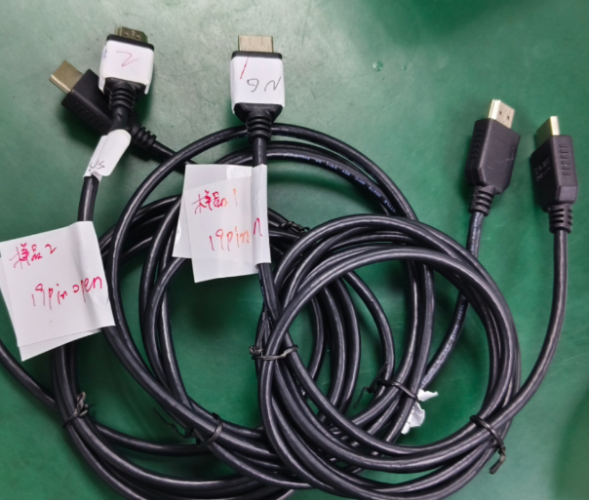
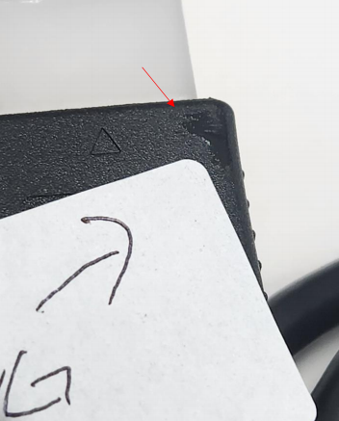
Problem Description
一.不良描述 (Defect Description)
4月1日，客户投诉在进料检验过程中，抽检1000pcs，有2pcs功能不良，1pcs外观不良，如下图。
On April 1st, the customer complained that during the incoming material inspection process, 1000 pcs were randomly inspected, and it was found that 2 pcs had functional defects and 1 pc had appearance defects, as shown in the figure below
1#樣品
sample 1
2#樣品
sample2
3#樣品
sample3

Slide 4
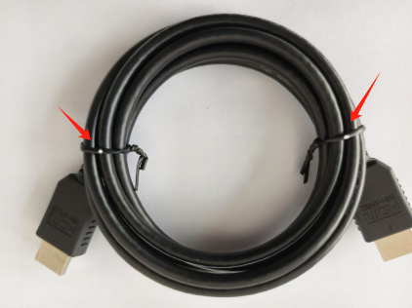
Containment Action
二. 庫存處理 (Stock/Inventory Handling):
2.1 廠內無庫存 No stock available in-house
2.2 無在途品 No goods in transit
2.3 越南仓库库存60K，安排重工处理，重工SOP见附件 Current Vietnam warehouse stock: 60,000 units requiring rework.
The rework standard operating procedure (SOP) is attached for reference.
重工后在扎带上打点
After rework, dots were marked on the cable ties
.

Slide 5
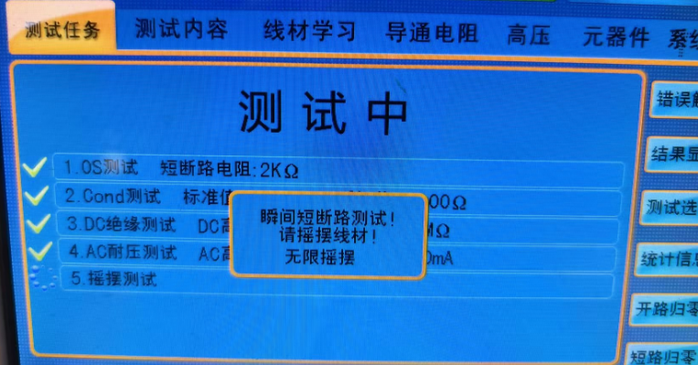
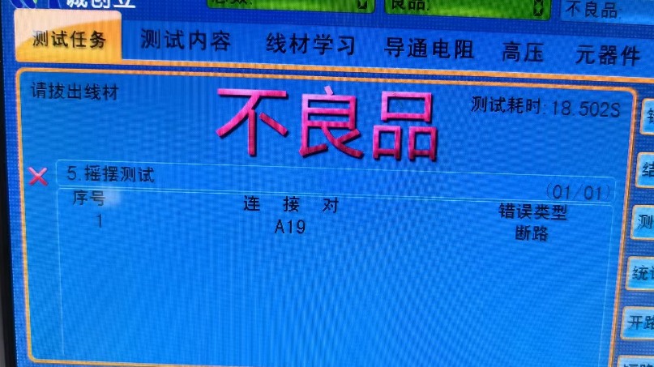
Root Cause Analysis
三. 不良分析(Failure Analysis):
3.1 不良原因分析: 3.1 Analysis of Defect Causes:
3.1.1 對1#、2#不良sample电气復測，折彎90度摇摆测试，發現摇摆瞬断不良，不良PIN显示都為第19PIN断路，如下图3.1.1 For the defective samples 1# and 2#, after retesting the electrical properties and conducting a 90-degree bending and shaking test, it was found that the shaking test resulted in intermittent disconnections. The defective pins were identified as the 19th pin being open-circuited, as shown in the figure below
对3#外观不良样品，电气测试OK For the 3# sample with appearance defects, the electrical test was OK.
摇摆前
Before shaking
摇摆后，断19PIN
After shaking, the 19th pin is disconnected.

Slide 6
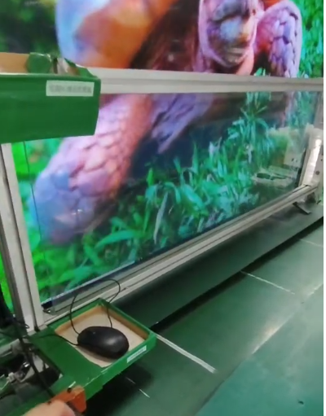
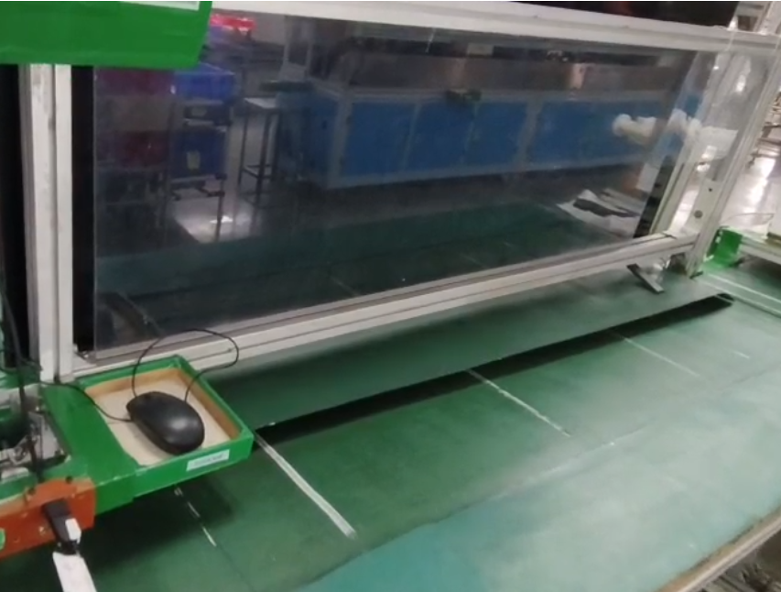
Root Cause Analysis
三. 不良分析(Failure Analysis):
3.2 不良原因分析:Analysis of the cause of the defect:
3.2.1 對1#、2#不良sample，做电视测试，当进行上下90度摇摆时，出现瞬间黑屏现象，如下图For the defective samples 1# and 2#, when conducting a TV test and performing a 90-degree up-and-down shaking test, an instantaneous black screen phenomenon occurred, as shown in the figure below.
对3#外观不良样品，测试电视OK For the sample 3# with appearance defects, the TV test was OK
摇摆前，画面正常
Before shaking, the picture was normal
90度摇摆后，画面黑屏
After a 90-degree shake, the screen goes black

Slide 7
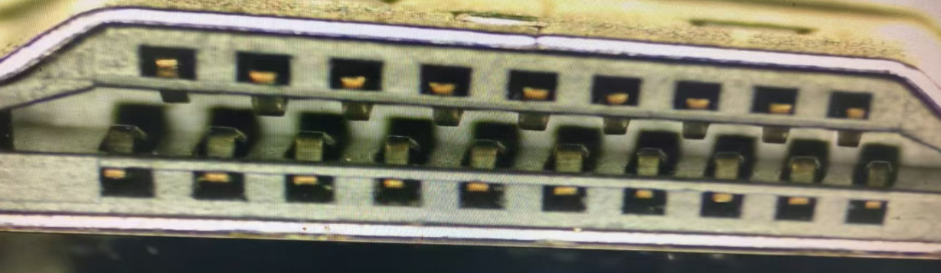
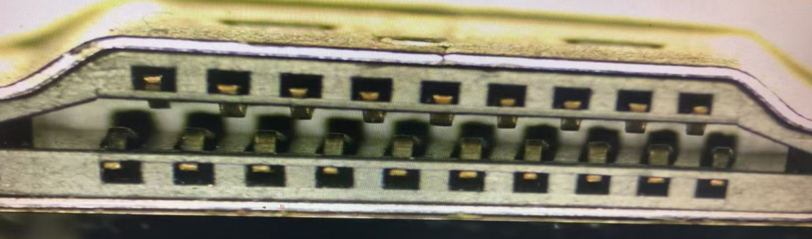
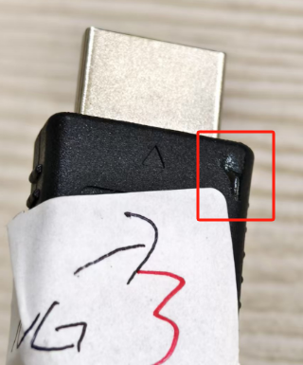
Root Cause Analysis
3.2.2 对1#、2#不良样品，进行胶芯外观确认无异常，3#外观不良样品，确认外模沾胶水，如下图：
For the defective samples 1# and 2#, the appearance of the rubber core was checked and no abnormalities were found. For the sample 3# with appearance defects, it was confirmed that the outer mold was contaminated with glue, as shown in the figure below:
1#样品胶芯正常
The rubber core of sample 1# is normal.
2#样品胶芯正常
The rubber core of sample 2# is normal.
3#样品外模粘胶水The outer mold of sample 3# is contaminated with glue.

Slide 8
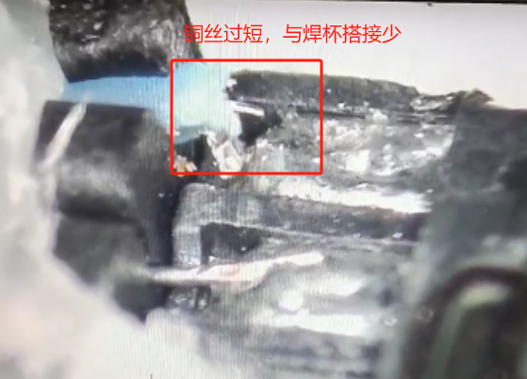
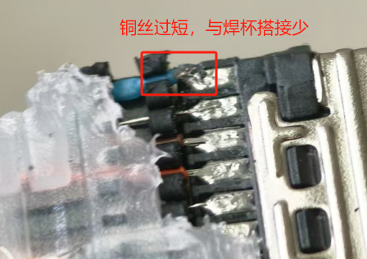
Root Cause Analysis
3.2.3 对1#、2#样品进行解剖分析，发现两个样品都是第19PIN铜丝过短，铜丝与焊杯搭接过少，导致摇摆断线不良，如下图
For samples 1# and 2#, a dissection analysis was conducted, and it was found that in both samples, the copper wire of the 19th pin was too short, and the overlap between the copper wire and the solder cup was insufficient, leading to the intermittent disconnection during the shaking test, as shown in the figure below
1#样品19PIN铜丝过短，与焊杯搭接过少The copper wire of the 19th pin in sample 1# is too short, and the overlap with the solder cup is insufficient.
2#样品19PIN铜丝过短，与焊杯搭接过少The copper wire of the 19th pin in sample 2# is too short, and the overlap with the solder cup is insufficient.

Slide 9
Root Cause Analysis
3.3.1 对工艺流程分析，锁定不良工站为橙色填充工艺，如下图：
脱外被
前处理
排线
检查色序
剥线沾锡
组装插头
焊芯线
点胶组装外壳
T3测试
自动铆压
T2测试
成型内模
T1测试
焊点检查
T4摇摆测试
TV测试
外观检验
CCD检验胶芯
套防尘盖
包装
产生原因：Root Cause
1#、2#样品，电气不良产生工站是剥线沾锡站，因剥线时，剥刀上沾线皮，未及时清理，导致剥线时有铜丝夹断，出现铜丝偏短的现象The station causing the electrical defect in samples 1# and 2# is the wire stripping and tinning station. During wire stripping, the wire stripper gets contaminated with wire insulation, which was not cleaned in time. This led to the copper wire being pinched and broken during stripping, resulting in the copper wire being shorter than required.
3#样品，外模沾胶不良产生的工站是点胶组装外壳站，正常是需要线材分开摆放点胶，但由于点胶过程中，外模交叉堆积，导致胶水沾到外模上。The station causing the appearance defect in sample 3# is the adhesive application and assembly station. Normally, the wires should be placed separately for adhesive application. However, during the adhesive application process, the outer molds were stacked crosswise, resulting in adhesive contamination on the outer mold.

Slide 10
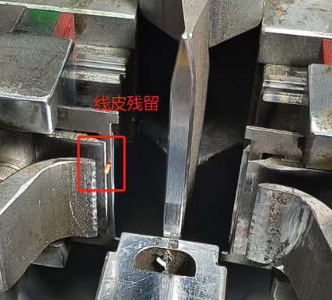
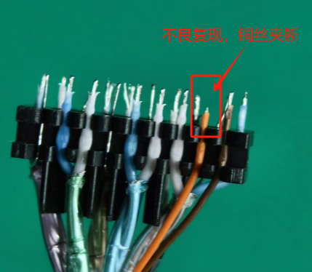
Root Cause Analysis
3.4 產生原因分析Root Cause
3.4.1 电气不良产生原因：剥线机刀片沾线皮，没有及时清理，残留线皮与芯线重叠，导致剥线时芯线铜丝被夹断，如下图
Cause of the electrical defect: The wire stripper blade was contaminated with wire insulation, which was not cleaned in time. The residual insulation overlapped with the core wire, causing the core wire copper to be pinched and broken during wire stripping, as shown in the figure below
剥线刀口残留线皮状态
The condition of residual wire insulation on the wire stripper blade
不良复现验证，铜丝夹断
Verification of defect reproduction, the copper wire is pinched and broken.

Slide 11
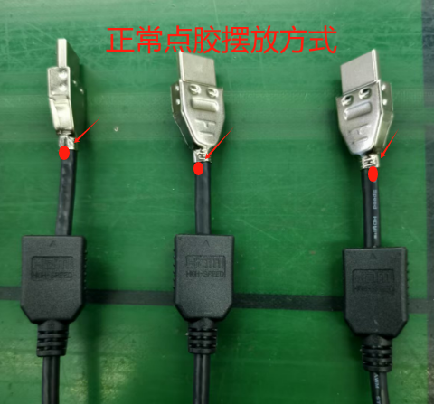
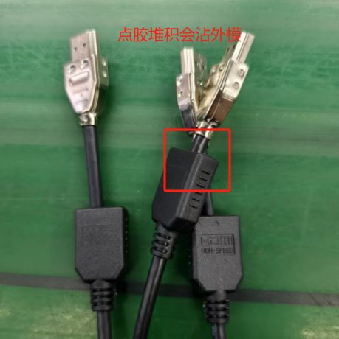
Root Cause Analysis
3.4 產生原因分析
3.4.2 外观不良产生原因：点胶过程中，未按要求分开摆放线材，外模交叉堆积，导致胶水沾到外模上。
Cause of the appearance defect: During the adhesive application process, the wires were not placed separately as required, and the outer molds were stacked crosswise, resulting in adhesive contamination on the outer mold.
正常点胶摆放方式The correct way of placing the wires for adhesive application
错误的点胶摆放方式The incorrect way of placing the wires for adhesive application

Slide 12
Root Cause Analysis
3.5 流出原因分析
3.5.1 电气不良流出原因是，员工没有严格按上下90度摇摆测试，对不良复测过程中发现，摇摆幅度在45-60度左右，电测和电视都是OK的，而当上下90度左右摇摆幅度时，不良呈现摇摆不良，如下图： The reason for the electrical defect leakage is that the employees did not strictly follow the 90-degree up-and-down shaking test. During the retesting of the defects, it was found that when the shaking amplitude was around 45-60 degrees, both the electrical test and the TV test were OK. However, when the shaking amplitude was around 90 degrees up and down, the defect of intermittent disconnection during shaking appeared, as shown in the figure below:
3.5.2 外观不良流出原因，外模沾胶水不良比较少，外检人员未重点关注该项不良，导致检验有漏失。
The reason for the appearance defect leakage is that the contamination of the outer mold with glue is relatively minor. The inspectors did not focus on this type of defect, resulting in the oversight during the inspection process.
摇摆幅度在45-60度,未显示不良
The shaking amplitude is between 45-60 degrees, and no defects are shown.
摇摆幅度在90度时,显示断路不良When the shaking amplitude is at 90 degrees, an open circuit defect is shown

Slide 13
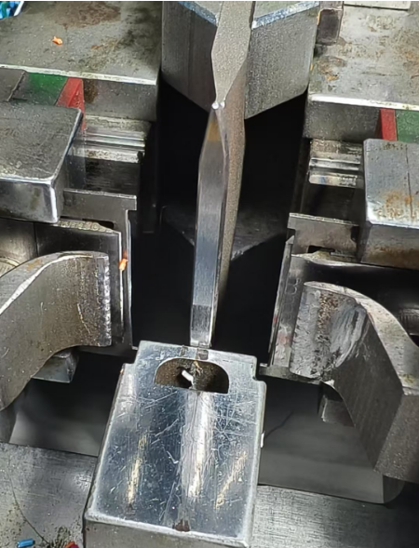
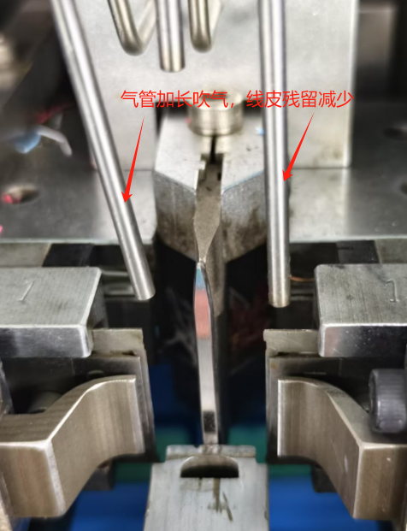
Corrective Action
四. 改善對策(Corrective Actions):
4.1 不良產生原因改善
4.1.1 对剥线机进行改善，目前在寻新的剥线机设备，提高剥线质量，临时对吹气装置进行改进，确保刀片上无线皮残留，如下图
----PT:程如意 DATA: 2025/6/9
Improvements have been made to the wire stripper. Currently, we are looking for new wire stripper equipment to improve the quality of wire stripping. In the meantime, the air-blowing device has been improved to ensure that there is no residual wire insulation on the blade, as shown in the figure below.
改善前：气管长度短，吹气不集中，容易吹不掉线皮Before improvement: The air pipe was too short, and the air blowing was not focused, making it difficult to remove the wire insulation
改善后：气管长度加长吹气，大大降低线皮残留After improvement: The air pipe has been extended to increase the blowing distance, which significantly reduces the residual wire insulation.

Slide 14
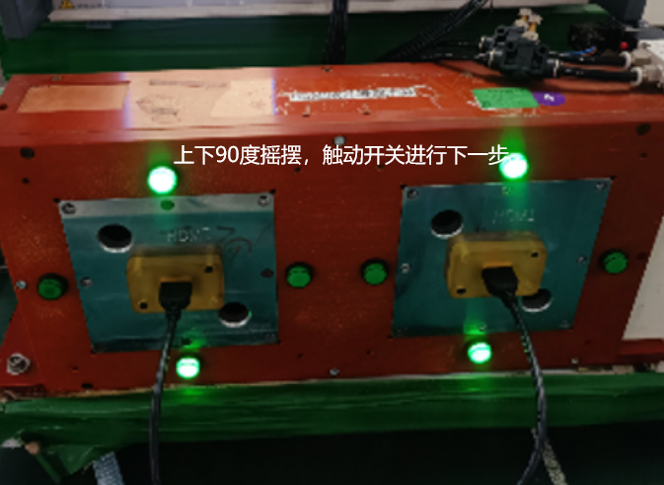
Corrective Action
四. 改善對策(Corrective Actions):
4.2 不良流出原因改善Improvement of the reason for defect leakage
4.2.1 搖擺測試角度在治具上做防呆管控，必须要摇到90度，触碰开关进行下一步测试，如下图
The shaking test angle is controlled by a foolproof mechanism on the fixture, ensuring that the test must reach 90 degrees and trigger a switch to proceed to the next step, as shown in Figure
4.2.2 摇摆测试再增加一道，200%摇摆测试，防止有漏测现象。 An additional shaking test has been added, with a 200% shaking test to prevent any missed tests. ----ME:言文明/QE:丁金花 DATA: 2025/6/9
脱外被
前处理
排线
检查色序
剥线沾锡
组装插头
焊芯线
点胶组装外壳
T3测试
自动铆压
T2测试
成型内模
T1测试
焊点检查
T4摇摆测试
T5摇摆测试
TV测试
外观检验
CCD检验胶芯
套防尘盖
包装
改善后，摇摆测试角度达到90度，触动开发才进行下一步After the improvement, the shaking test angle reaches 90 degrees, and only then does the switch trigger to proceed to the next step.
改善后，增加一道摇摆测试，200%测试，防止有漏测现象After the improvement, an additional shaking test has been added, with a 200% test to prevent any missed tests.

Slide 15
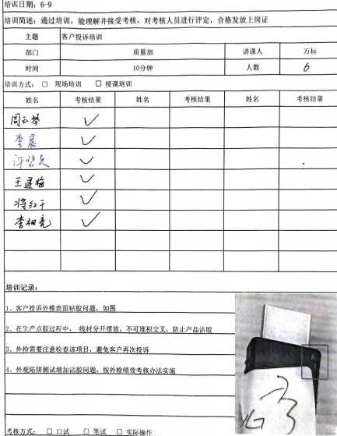
Corrective Action
四. 改善對策(Corrective Actions):
4.3 外观不良流出原因改善Improvement of the reason for defect leakage
4.3.1 对外检人员做培训，并增加外模沾胶水问题陷阱测试考核，提高员工警惕度。
Conduct training for external inspectors and introduce a trap test assessment on the issue of foreign molds being glued to enhance employee alertness.

Slide 16
Preventive Action
相關改善對策文件標準化
Standardization of related corrective actions. ----PE: 姜金平 Due date: 2025/6/9

Slide 17
Closure Verification
追蹤三批改善新品在客戶端使用狀況
Keep monitoring the product performance on customer site for 3 batches.
----QE: 丁金花 Due date: On-going

Slide 18
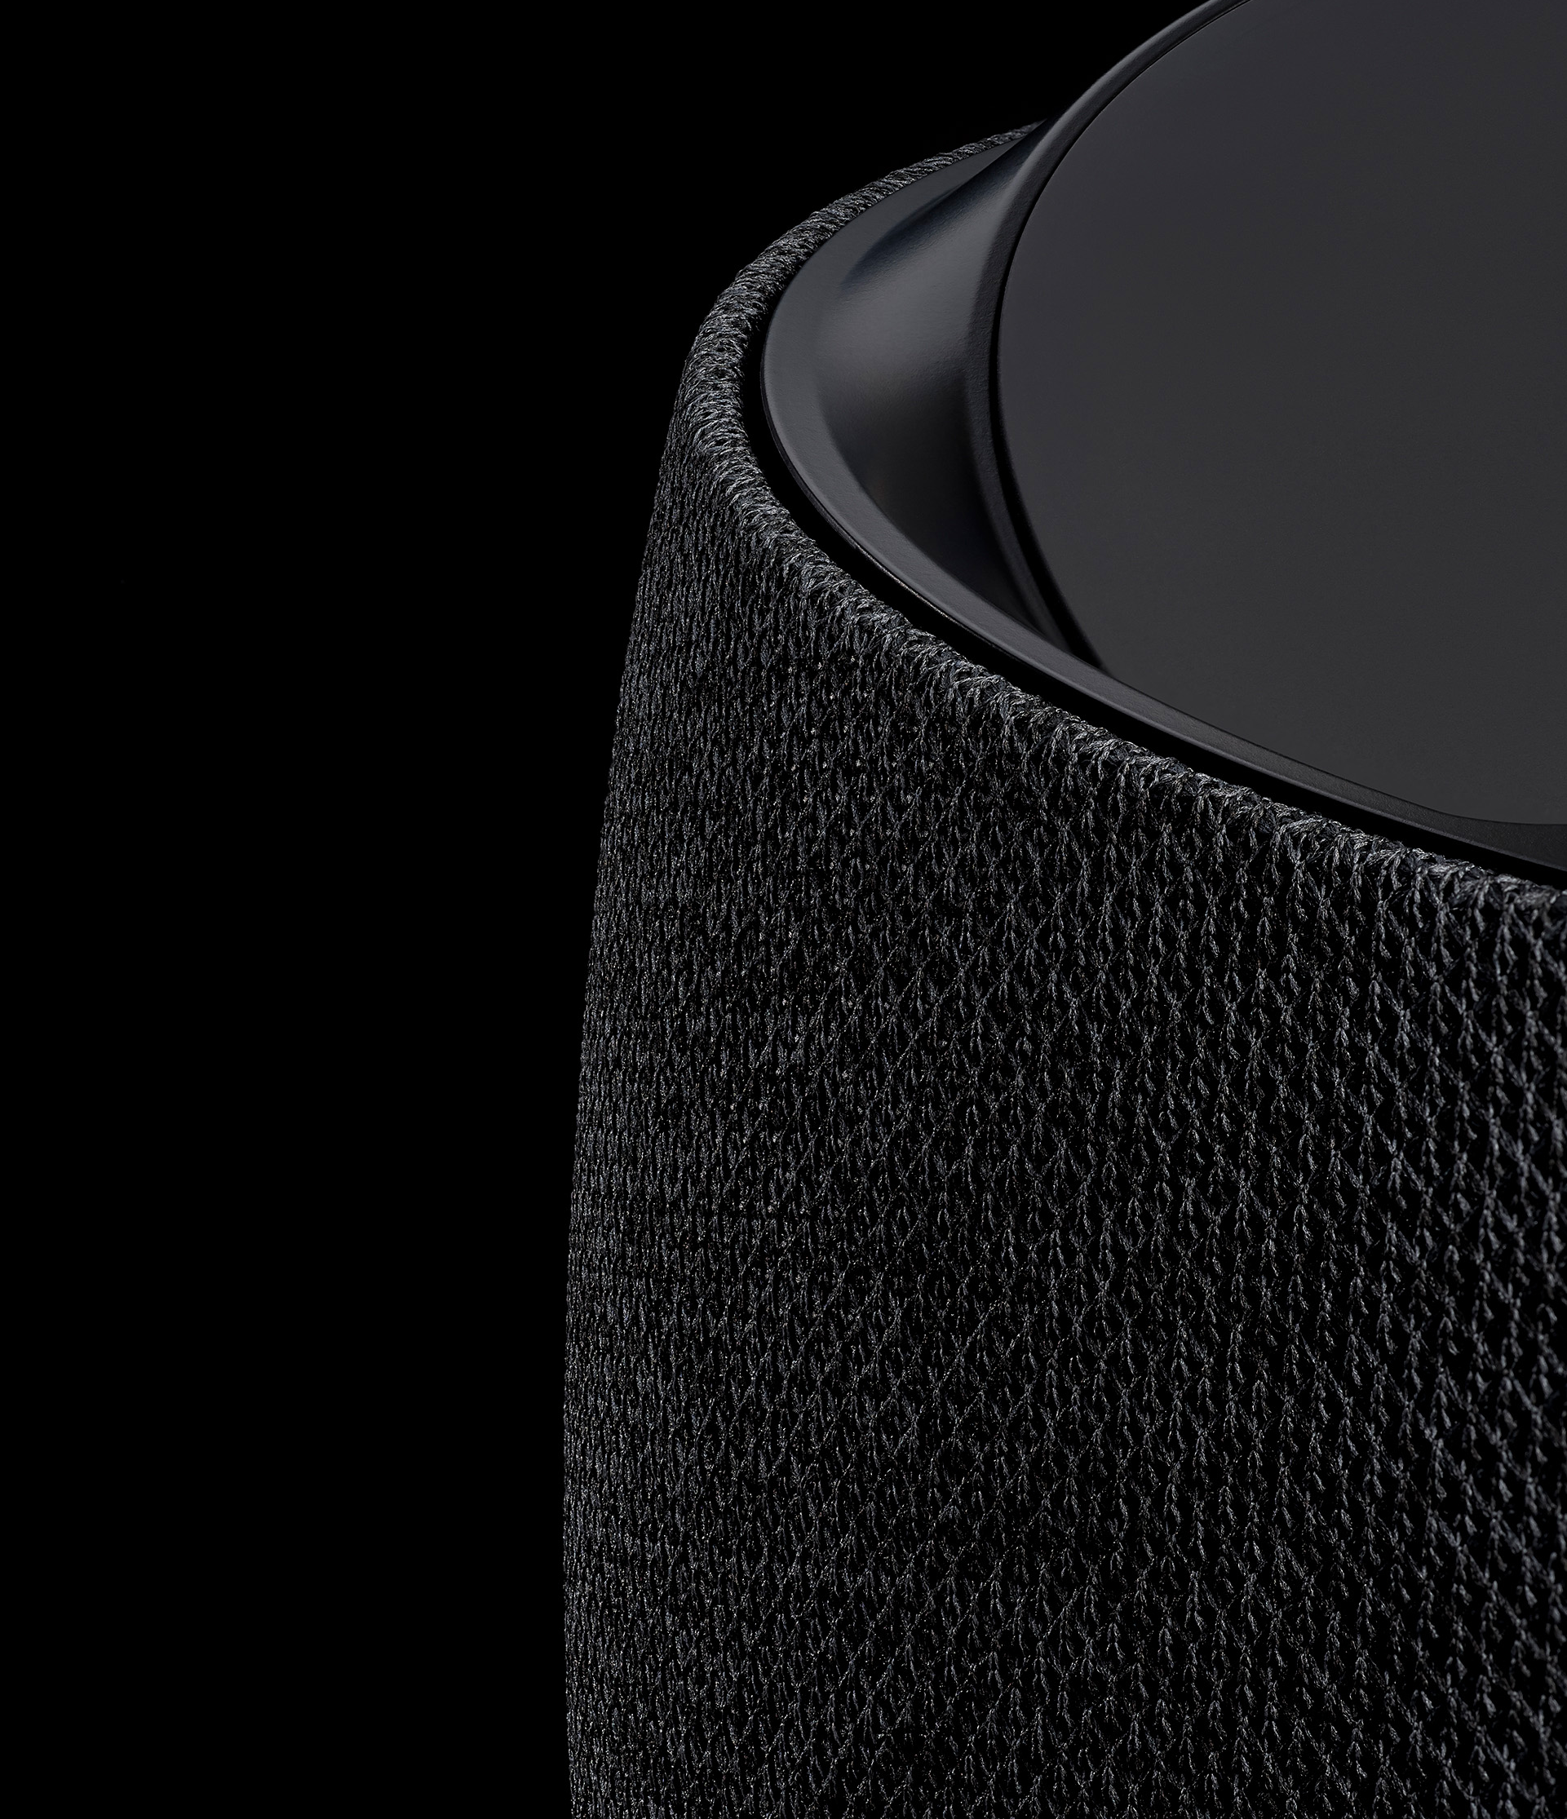
Thank you
Foxconn Interconnect Technology Limited (Incorporated in the Cayman Islands and carrying on business in Hong Kong as FIT Hon Teng Limited)
鴻騰精密科技股份有限公司 (於開曼群島成立，並以鴻騰六零八八精密科技股份有限公司於香港經營業務）

