Slide 1
Audio policy for AI2MAX
Version : 0.1
Issue date : 2020.12.14

Slide 2
ALL Cases for Audio Routing:
음원 Source | 연결상태 ( connection status ) |  |  |  |  | 소리 출력 | Sound Ouput | Other
 | STB Speaker | HDMI (TV Speaker) | BT Source (RCU earphone) | BT Sink (Mobile phone) | AUX In
BTV | O | O | X | X | X | STB Speaker로만 BTV 출력 | Out BTV from STB Speaker | Display only video in HDMI
 | O | O | O | X | X | BT Source로만 BTV 출력 | Out BTV from BT Source
 | O | O | X | O | X | BTV Mute하고, 연결된 BT Device 소리를 STB Speaker로 출력 | After mute BTV, Out "BT Device" from Speaker | It is same with AI2
 | O | O | X | X | O | BTV Mute하고, AUX In 소리를 STB Speaker로 출력 | After mute BTV, Out "Aux in" from Speaker | Automatically change path to AUX IN usingH/W detection
 |  | O | O | X | O | BT Source로 BTV출력, AUX In 소리 STB Speaker로 출력 | Out BTV from BT Source, Out AUX in from STB Speaker | Consists of the same scenario considering the connection status of the whole family Earphone ??
 | O | O | X | O | O | Aux In 소리를 STB Speaker로 출력 | Out Aux In from STB Speaker | Increased Priority to wire than BT Sink
 | X(External device connection in settings) | O | X | X | X | HDMI | HDMI | Pass-Through Mode enabled
NUGU TTS | Default output from STB Speaker
TV's own app (Netflix or YouTube, etc.) | "The only way to output TV's audio to the soundbar set-top box, not the TV speaker, is BT & AUX In. S/PDIF Input and HDMI RX(ARC) are not supported by Synaptics BG5CT(VS550)"

Slide 3
RCU volume key up/down/mute
This will be handled by MW
adjustStreamVolume()
setStreamVolumeIndex()
Android
Audioservice.java
AudioPolicyManager.cpp
setStreamVolumeIndex() {
float gain = 0;
if (stream == AUDIO_STREAM_MUSIC)
gain = getStreamVolumeDB(AUDIO_STREAM_BTV, index, device);
else
gain = getStreamVolumeDB(stream, index, device);
int ret = set_btv_media_volume(volume_index, gain);
}
BtvMediaVolumeControlLib
set_btv_media_volume(index, gain){
//to do call: Synaptics BTV volume control api
}
BTF
Synaptics BTV volume control
Synaptics

Slide 4


STREAM Type
Passthrough OFF and BT connect-> BT Speaker
BTV / Other
Passthrough ON -> HDMI
NUGU
Passthrough OFF -> Speaker
NUGU_TTS
NUGU_CALL
Passthrough ON/OFF Speaker only
NUGU_RING

Slide 5
Nugu start : nugu_playback=on Nugu end : nugu_playback = off
STREAM Type
param.add(String8("nugu_playback"), String8("off"));
AudioSystem::setParameters(AUDIO_IO_HANDLE_NONE/*mOutput*/, param.toString());
Passthrough on && nugu_playback = off
Change Device HDMI
NUGU
param.add(String8("nugu_playback"), String8(“on"));
AudioSystem::setParameters(AUDIO_IO_HANDLE_NONE/*mOutput*/, param.toString());
NUGU_TTS
Passthrough on && nugu_playback = on
Change Device Speaker
NUGU_CALL
NUGU_RING
MW is in charge of call setParameters with “nugu_playback” parameters.
OEM vendor is in charge of implementing the switch audio output path.

Slide 6
Whole Family Earphone support (WFE)
1. WFE Start
param.add(String8(“audio_output_type"), String8(“am"));
AudioSystem::setParameters(AUDIO_IO_HANDLE_NONE, param.toString());
Speaker = mute, Hdmi = mute, WFE = unmute
2. WFE Stop
param.add(String8(“audio_output_type"), String8(“normal"));
AudioSystem::setParameters(AUDIO_IO_HANDLE_NONE, param.toString());
Back to previous setting
***
If there is aux input, Aux should be output from internal speaker and BTV should be out “WFE”

Slide 7
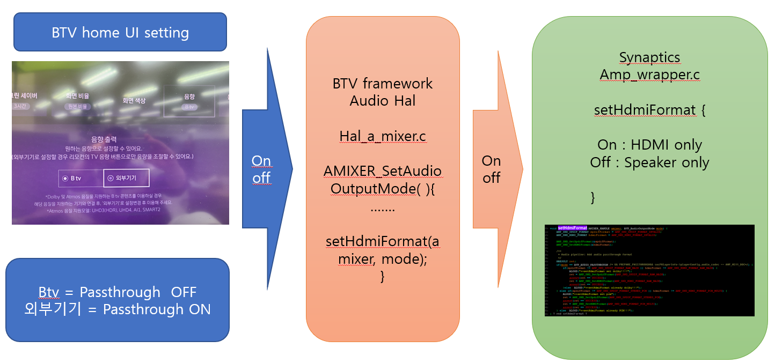
UI Setting for Pass Through mode code location:
OEM vendor need to add code in setHdmiFormat() to switch audio routing output device to HDMI .

