Slide 1
AI 2 Max (BFX-UA300)
LED Motion Guideline_v1.4
2021.01.25

Slide 2
Major fixes (after 12/29 tuning meeting)
Indicator LED:
Corrected by blinking once when RCU is received (currently blinks twice)
Fix by white light on boot (manual/active standby mode -> fix by light on STB on)
NUGU LED:
- Common content: Scenarios with full LED on smoother handling of both ends (see page 16 of this article)
- See each page for detailed scenario fixes.
Sound field mode LED:
Auto mode color added (pink)
Define color change time (0.7 seconds, only medium black additions will be determined based on 1/8 prototyping)

Slide 3
Revision History
Ver. | Date | Content | Writer | Remark
0.4 | 2020.07.28 | Indicator LED, side sound field mode LED scenario drafting | SKB
0.5 | 2020.08.05 | Draft nugu LED scenarios | SKT
0.7 | 2020.09.14 | Ai 2 Development Update | SKB
0.8 | 2020.10.29 | Added a description of the update history of the discussions at the time of AI 2 development | SKB
1.0 | 2020.11.12 | Published separately published indicator LED, NUGU LED, side sound field mode LED scenario integration document | SKB
1.1 | 2020.12.29 | Modify scenarios after LED tuning (add time, color addition, and video examples ) | SKB
1.2 / 1.3 | 2021.01.12 | Chang Color RGB Value after LED second tune LED (p. 11, 13, 26) Adjust transition speed of sound field side LED (p. 29) | SKB
1.4 | 2021.01.25 | Change Color RGB Value after LED 4th tune LED (p. 13 change orange colort, p.26 change bleu color) Change Volume control scenario | SKB

Slide 4
Index
<1. DEFINING LEDS>
1.1 LED Defining Elements
1.2 Hardware Spec Of LEDs
<2. Indicator LED>
2.1 Indicator LED – Defining interactions
2,2 Indicator LED - Color
<3. NUGU FFV LED>
3.1 NUGU FFV LED – Defining interactions
3.2 NUGU FFV LED – Agent State Representation(Agent States)
3.3 NUGU FFV LED – Device status representation (Device States)
3.4 NUGU FFV LED – caution, notifications (Alerts)
<4. Sound filed LED>
4.1 Sound field Side LED – Defining interactions
4.2 Sound field Side LED – Color transitions (Color Transition)

Slide 5
Document Guide
1. Changes legend
Show tags in the upper right corner of the page, as shown on the right
When modifying to the next scenario version, the tag is cumulatively generated without clearing the tag
* Previous tags are arranged so that date and version information can be seen (2-1)
* Arranged so that only the date and version information of the two most recent tags can be seen when the content of the page is covered by tags. (2-2)
Entry information in tags
- date, document version
- Update content
: When filling in, use the word 'edit(or change)/delete/add'
Tag color is used by selecting a color that does not overlap the previous version when modifying the next scenario version
(2-1)
YYYY.MM.DD_v0.01
Revison 1 Revison 2
YYYY.MM.DD_v0.01
수정 사항 1 수정 사항 2
YYYY.MM.DD_v0.02
수정 사항 1 수정 사항 2
YYYY.MM.DD_v0.03
Revison 1 Revison 2
(2-2)
YYYY.MM.DD_v0.01
수정 사항 1 수정 사항 2
YYYY.MM.DD_v0.02
수정 사항 1 수정 사항 2
YYYY.MM.DD_v0.03
수정 사항 1 수정 사항 2
YYYY.MM.DD_v0.04
수정 사항 1 수정 사항 2
YYYY.MM.DD_v0.05
Revison 1 Revison 2
2020.MM.DD_v1.06 (PA용)
Revison 1 Revison 2

Slide 6
1. LED Defined

Slide 7
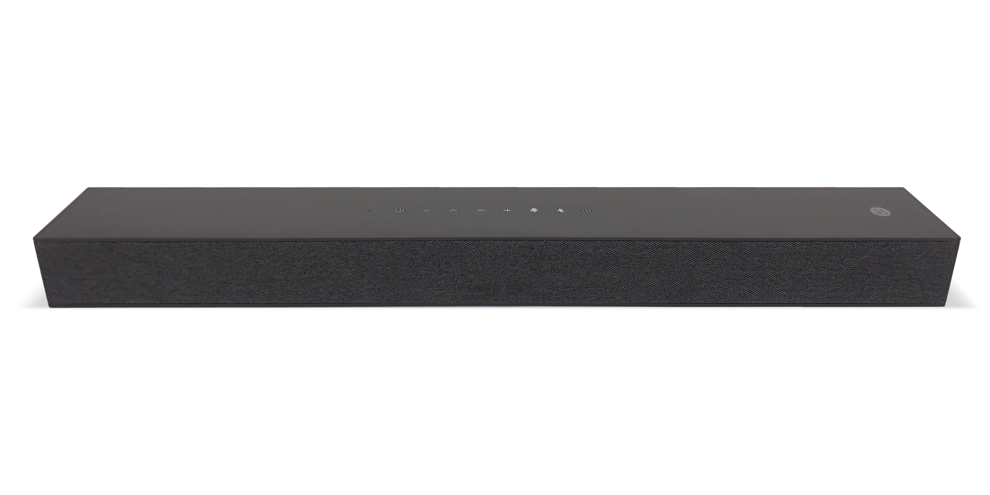
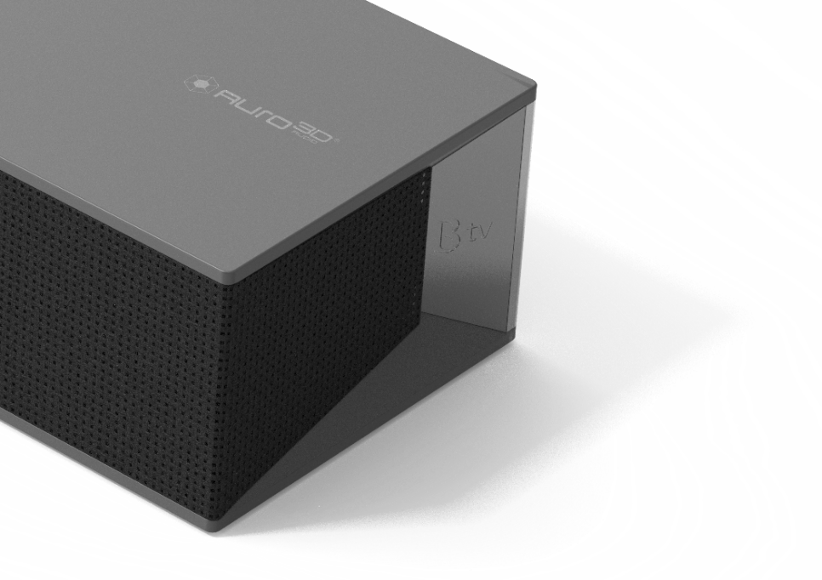

1.1 LED component definition
20mm
30mm
4
1
2
50mm
3
1
B tv x NUGU FFV LED:
It is indicate LEDs for STB Volume / NUGU Volume and NUGU Status (full color)
2
Google Assistant LED:
LED for Google Assistant(full color)
3
STB Indicator LED:
Power Status + Network status + STB Status integrated LED (full color)
4
Sound Field Effect LED:
It shows the mode of the sound field effect (full color)
7

Slide 8
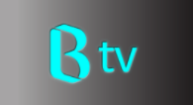
1.2 LEDs Hardware Spec.
1) STB Indicator LED
2) NUGU FFV LED
50mm position/diameter 3mm from top
RGB Color 1ea LED
Exposure as sharp as possible in a circular way
See detailed guide for color/motion
150mm (Minimum 145mm)
2mm
1
2
3
front
3) Sound field LED
RGB Color 2ea LED
Place on left and right side
1
3
스피커 패브릭
LED
2
확산판
4) Google Assistant LED
30mm position at top
Diameter 3.5mm / Gap 3.5mm respectively
RGB color 4ea LED
Four prototypes exposed as clearly as possible
See Google Nest and Google Home device LED lights for motion behavior https://support.google.com/googlenest/answer/7073219?hl=en
Lighting area 150mm x 2mm
RGB Color 21ea LED
20mm position at top
Lighting that is connected smoothly through the entire area without led spot(Ai 2 STB Lighting Connectivity Note )
  LED spacing is 7 to 7.3 mm (boundaries occur when 7.5 mm begins to cross)
  LEDs are placed horizontally to reduce light spot
* Get the same as possible with Google Home mini

Slide 9
2. Indicator LED

Slide 10
2.1 Indicator LED – Defining interactions
Defining LED Status | Light on | Flashing | Lights off
 | ON | 1000ms light on – 500ms light off Repeat until the end of the situation | OFF
구분 | Situation | LED
 |  | 셋톱박스 status LED (RGBW)
1 | Power Off | ○ Off
2 | STB Booting | ● White Light on (To be reflected)
2-1 | [STB active standby mode -> STB normal operation] switching
2-2 | [STB low power standby mode → STB normal operation] conversion
3 | STB normal operation (including network normal) | ● White Light on
4 | STB network abnormal | ● Red flashing
5 | Receiving RCU keys (only during STB normal operation) | ● White 1 time flashing (To be reflected)
6 | STB Active Standby Mode | ● Green Light on
7 | STB Low Power Standby Mode | ● Blue Light on

Slide 11
2020.07.23_v0.5
Interaction color also TBD Full color is likely to be adjusted after implementation
2.2 Indicator LED – Color
 | System Color | Uses
1 | White R:255 G:255 B:255 | When receiving a normal / boot / RCU
2 | Green R:120 G:255 B:115 | Active standby
3 | Blue R:140 G:165 B:225 | Low power standby
4 | Red R:255 G:0 B:0 | Network Error

Slide 12
3. NUGU FFV LED

Slide 13
2020.09.14_v0.7
Modifications to the blue text are updated (based on AI 2), and more details are mentioned on each page..
3.1 NUGU FFV LED – Defining interactions
The NUGU platform uses a total of five Lighting Color depending on the States to provide a consistent user experience and to communicate interactions simply and clearly
Agent States
Device States
Caution alerts
Voice Assistant
Notification
Device status notifications
System Status Alerts
Blue
RGB (140,165,225)
White
RGB(220,105,80)
Red
RGB(X,X,X)
White
RGB(220,105,80)
Green
RGB (120,255,115)
Orange
RGB(255,35,0)
Listening
Timer
Volume Level Status
AP Standby Status
Thinking(Processing)
Alarm
Mute
Wi-Fi connection status (not available)
Speaking
Call/ Ringtone
(Exception) BT Connection Status (blue))
System Boot
Mic On/Off Status Notification
Update state (not found)
Red
RGB (255,0,0)
System Initialization
Error (fail_connection_error)
※ During warning notification,
System status error is displayed first
※ During wake-up during Device States notification, Agent States notification is displayed first.

Slide 14








2020.09.14_v0.7
Listening end value is not separately applied – (Based on AI 2)
3.2 NUGU FFV LED – Agent State Representation (Agent States) (1/2)
AI STB 2, AI 2 Max
albert AI
Status
Description
Lighting Color
Animation (Linear)
Animation (Radial)
Animation (Single)
Sound
TTS
1
Idle
Standby state available for wake up
N/A
N/A
N/A
N/A
N/A
N/A
When the user calls a button or voice and the microphone is activated, the corresponding lighting is played.
If the user's location can be determined and the direction of the LED can be controlled, the lighting is directed toward the user's voice.
Play once
<2020.12.29 Tuning history>
- Slow speed -> fast (to be reflected)
Listening Start
N/A
Blue
RGB (0,158,255)
Default: OFF → ON
The corresponding lighting stays on continuously while waiting for input or while the user is saying.
If the user's location can be determined and the direction of the LED can be controlled, the lighting is directed toward the user's voice.
Motion: N/A (100% On Status)
<2020.12.29 Tuning history>
- keep
2
Listening
Listening
(Passive/ Active)
N/A
N/A
Blue
RGB (0,158,255)
<2020.12.29 Tuning history>
- Not applicable
(Based on AI 2) Speaking End LED
The scenario did not apply that value.
Listening End
사용자의 발화 입력이 완료되거나 일정 시간이 지나 마이크가 꺼지게 되면 해당 라이팅이 재생됩니다
1회 재생
N/A
Blue
RGB (0,158,255)
ASR result/ cancel
Default: OFF → ON
※ The RGB color values indicated in the document are for reference only, and when implementing actual lighting, a color similar to that of the document is required.

Slide 15


2020.09.14_v0.7
Speaking end value has not been applied separately – ( AI 2 기준)
3.2 NUGU FFV LED – Agent State Representation (Agent States) (2/2)
AI STB 2, AI 2 Max
albert AI
Status
Description
Lighting Color
Animation (Linear)
Animation (Radial)
Animation (Single)
Sound
TTS
The lighting is played continuously while analyzing and processing the input user's call.
Loop
<2020.12.29 Tuning history>
Keep current speed
Starting LED range (full 1/3), final LED range (full) value specified (to be reflected, see next)
Commonly used: Scenarios with full LED on handle both ends more smoothly(to be reflected)
3
Processing
N/A
N/A
Blue
RGB (0,158,255)
The lighting plays continuously while responding to a user's request from the start of the response.
Loop
<2020.12.29 Tuning history>
Dissolve in/out slow down (to be reflected)
Need to change starting color (blue) and final color (cyan) (To be reflected)
Common Modification: Scenarios involving all LEDs on smoother both ends (To be reflected)
Speaking
N/A
Blue
RGB (0,158,255)
4
Speaking
Starting color
Final color
<2020.12.29 Tuning history>
- Not applicable
(Based on AI 2) Speaking End LED
The scenario did not apply that value.
사용자의 요청에 대해 응답을 완료한 후 Idle상태로 복귀하면 해당 라이팅이 재생됩니다
1회 재생
Speaking
End
N/A
N/A
Blue
RGB (0,158,255)
※ 문서에 표기된 RGB색상 값은 참고 용이며, 실제 라이팅 구현 시 문서와 유사한 Color 구현이 필요합니다

Slide 16
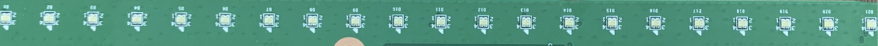
[Reference] The range of the start LED area and the final LED area range of the process scenario / the area that smoothly processes all LEDs
Start LED range : 7개
- Each LED on each side has a smooth light treatment by reducing the luminance
AI 2 max
Start/final LED length
** If all LEDs are on
Area to smooth the light on both sides
LED range: 21
- The brightness of each of the two LEDs on each side is reduced and the light is treated smoothly.
AI 2 max
Processing scenario video
(Can be checked with the Play button)

Slide 17
2020.09.14_v0.7
(Base on AI 2) Alarm & timer LED is not applied. Play 3 times Color is changed to blue from white (base on AI2 )
3.3 NUGU FFV LED – Device status representation (Device States) (1/5)
AI STB 2, AI 2 Max
albert AI
Status
Description
Lighting Color
Animation (Linear)
Animation (Radial)
Animation (Single)
Sound
TTS
(Based on AI 2) Alarm & timer LEDs
The scenario did not apply that value.
<2020.12.29 tunning history>
- Not applicable
사용자가 미리 설정한 Timer나 Alarm시간을 알려줄 때 라이팅을 재생하여 알려줍니다. 사용자가 중지시키기 전이나 정해진 시간 동안 연속적으로 재생됩니다
반복 재생 (Loop)
1
Alarm/ Timer
N/A
White
RGB(0,0,0)
Always ON
The state in which the user turns on the BT of the NUGU device with a voice or button
BT
Waiting for connection
N/A
N/A
N/A
N/A
N/A
(Play TTS lighting if there is a TTS that informs the connection waiting state)
When the user successfully connects the Bluetooth to the NUGU device using a mobile phone or other device, the corresponding lighting is played.
Play once play 3 times
Color is changed to blue from white (base on AI2 )
<2020.12.29 tunning history>
Dissolve in/out speed down (Reflected complete)
Dissolve in/out: With full brightness changes (will be reflected)
Common fixes: scenarios with LED full on handled more smoothly at both ends (will be reflected)
2
BT
BT
Connected
N/A
Always ON
White
RGB(0,0,0)
Blue
RGB (0,158,255)
When the Bluetooth connected to the NUGU device is disconnected, the corresponding lighting is played.
Play once play 3 times
Color is changed to blue from white (base on AI2 )
** Same as above
<2020.12.29 tunning history>
Dissolve in/out speed down (반영 완료)
Dissolve in/out : With full brightness changes (will be reflected)
Common fixes: Scenarios with full LED on are smoother at both ends (will be reflected)
BT
Disconnected
N/A
White
RGB(0,0,0)
Always ON
Blue
RGB (0,158,255)
※ The RGB color values in the document are for reference only, and a color implementation similar to the document is required for actual lighting implementations.

Slide 18

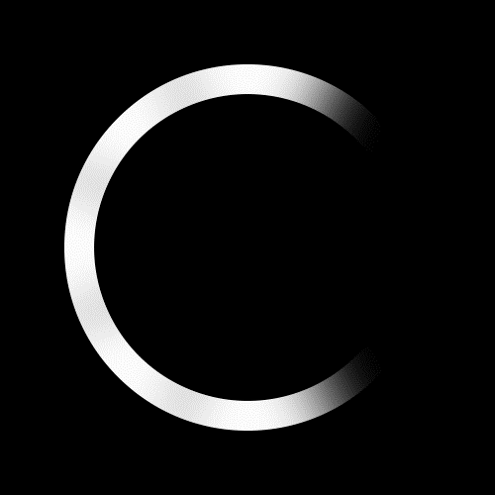
2020.09.14_v0.7
(Base on AI 2) Volumne up/down : motion of sweeping the entire length and filling the area as much as it goes up (Base on AI 2) Mute : It moves from the outside to the inside and keeps the lighting in the center stopped (Base on AI 2) Max : This value is not applied
3.3 NUGU FFV LED – 디바이스 상태 표현 (Device States) (2/5)
AI STB 2, AI 2 Max
albert AI
Status
Description
Lighting Color
Animation (Linear)
Animation (Radial)
Animation (Single)
Sound
TTS
When the user adjusts the volume with a button or voice, the corresponding lighting is played once.
The volume level is played by dividing the maximum and minimum values that can be displayed in a total of 10 steps 32 steps.
(Use of lighting brightness, range, etc.)
Play once
** Need a review
<2020.12.29 tunning history>
The first step in showing full length (discussion required)
Common content: Scenarios with full LED on smoother handling of both ends (to be reflected)
Volume
Up
N/A
N/A
White
RGB(X,X,X)
(볼륨 레벨 단계를 표시할 수 없는 경우 라이팅을 재생 하지 않음)
Do not play Beepsound while playing media or TTS
When the user adjusts the volume with a button or voice, the corresponding lighting is played once.
Play once
** Need a review, same above
<2020.12.29 tunning history>
The first step in showing full length (discussion required)
Common content: Scenarios with full LED on smoother handling of both ends (to be reflected)
Volume
Down
N/A
N/A
White
RGB(X,X,X)
(볼륨 레벨 단계를 표시할 수 없는 경우 라이팅을 재생 하지 않음)
Do not play Beepsound while playing media or TTS
3
Volume
When the device's volume is 0 or muted, the corresponding lighting is played and notified. (After the inner 4 LEDs turn on, it stays in the center.)
Play once
<2020.12.29 tunning history>
- Keep
Mute
N/A
N/A
White
RGB(X,X,X)
(Base on AI 2)
Volume Max is not applied that value.
<2020.12.29 tunning history>
- Not applicable
디바이스의 볼륨이 100값 또는 Max 상태일 때 해당 라이팅을 재생하여 알려줍니다
1회 재생
해당 값은 적용 안하였습니다.
Max
N/A
Do not play Beepsound while playing media or TTS
White
RGB(X,X,X)
※ The RGB color values indicated in the document are for reference only, and a color similar to the document must be implemented when implementing actual lighting.

Slide 19






NUGU Device LED Lighting UX _ Device States
AI STB 2
albert AI
Status
Description
Lighting Color
Animation (Linear)
Animation (Radial)
Animation (Single)
Sound
TTS
When a call is received on the user's device, the corresponding lighting is continuously played while the phone rings.
When a user makes a call through the device, the corresponding lighting is played continuously while the call ring tone sounds.
Play repeatly
<2020.12.29 tunning history>
- Need a speed up(to be reflected)
Ringtone
N/A
White
RGB(X,X,X)
Always ON
When the user's device is connected to the other party, the corresponding lighting is played.
play once
<2020.12.29 tunning history>
- Change -> in the left side to the whole (reflected)
- Change incoming speed, same speed as Ringtone (to be reflected)
Call Start
N/A
N/A
White
RGB(X,X,X)
4
Call
While the user is making a call with the other party, the corresponding lighting is played continuously.
Keep 100% On
<2020.12.29 tunning history>
- Keep
Calling
N/A
N/A
White
RGB(X,X,X)
When the call between the user and the other party ends, the corresponding lighting is played.
When a user rejects a call while receiving a call or cancels a call while receiving a call, the corresponding lighting is played.
Play once
** Need a review, same above
<2020.12.29 tunning history>
Change -> in the left side to the whole (reflected)
Change incoming speed, same speed as Ringtone (to be reflected)
Call End
N/A
White
RGB(X,X,X)
Always ON
※ The RGB color values indicated in the document are for reference only, and a color similar to the document must be implemented when implementing actual lighting.

Slide 20






2020.09.14_v0.7
(Base on AI 2) There are no wifi and not supported feedback of ap connection in NUGU LED, they are supported in STB Indicator
NUGU Device LED Lighting UX _ Device States
AI STB 2
albert AI
Status
Description
Lighting Color
Animation (Linear)
Animation (Radial)
Animation (Single)
Sound
TTS
**Review required, same as above <2020.12.29 tunning history>
Left → right change required (to be reflected)
When flowing, it should flow in green → blue color (to be reflected)
Common Modification: Scenarios involving all LEDs on smoother both ends (to be reflected)
When the system is automatically booted after the device is powered on, the corresponding lighting is played until the booting is completed.
Play once
1
System boot
N/A
Green
RGB (X,X,X)
Blue
RGB (X,X,X)
(base on AI 2)
The value was not applied to the Wi-Fi situation,
Provided by the Settop Box Indicator LED.
<2020.12.29 Tunning history>
- Not applicable
When booting is complete, the corresponding lighting is maintained while connecting the AP.
Keep 100% On
AP connection
Standby mode
N/A
Green
RGB(X,X,X)
When the device connects to WiFi, the corresponding lighting is played continuously from the start of the WiFi connection until the connection to the NUGU server is completed.
Repeat play
<2020.12.29 Tunning history>
- Not applicable
2
AP
connection
WI-Fi
Connecting
N/A
Green
RGB(X,X,X)
When the connection to the NUGU server is completed, the lighting is played once and the lighting is turned off.
Play once
<2020.12.29 Tunning history>
- Not applicable
WI-Fi connection connected
N/A
N/A
Green
RGB(X,X,X)
※ The RGB color values indicated in the document are for reference only, and a color similar to the document must be implemented when implementing actual lighting.

Slide 21
2020.09.14_v0.7
(Base on AI 2) Because NUGU update time is too short, this is not supported
NUGU Device LED Lighting UX _ Device States
AI STB 2
albert AI
Status
Description
Lighting Color
Animation (Linear)
Animation (Radial)
Animation (Single)
Sound
TTS
(Base on AI 2)
NUGU update time itself is short in set-top box
Not provided separately.
<2020.12.29 Tunning history>
- Not applicable
If the firmware of the latest version is automatically updated, the corresponding lighting is continuously played until the update is completed.
Repeat play
3
System upgrade
N/A
Green
RGB(X,X,X)
※ The RGB color values indicated in the document are for reference only, and a color similar to the document must be implemented when implementing actual lighting.

Slide 22


2020.09.14_v0.7
(Base on AI 2) when Mic On → Off, led play 3 times and there is no states area. (AI 2 기준) when Mic is Off, there is no states area.
NUGU Device LED Lighting UX _ Attention notification
AI STB 2
albert AI
Status
Description
Lighting Color
Animation (Linear)
Animation (Radial)
Animation (Single)
Sound
TTS
When the user turns off the device's microphone (On -> Off), the corresponding lighting is played.
** Review required, same as above
<2020.12.29 tunning history>
Common Modification: Scenarios involving all LEDs on smoother both ends(To be reflected)
Interaction
area
(LED play once)
(LED play 3 times)
Mic
On->Off
N/A
<2020.12.29 tunning history>
- Not applicable
Beep sound production required
(In case voice and commands)
States display
area
Orange
RGB(237,125,50)
(LED Off→On)
1
Mic
Delete as a duplicate guide
The corresponding lighting is maintained while the device's microphone is off
Interaction
area
OFF
OFF
OFF
(LED Off)
Mic Off
N/A
N/A
States display
area
Orange
RGB(237,125,50)
(LED 100% On)

Slide 23

2020.09.14_v0.7
(Base on AI2) Mic Off → On : Provider one time motion. There is no status display area. When user call in mic off, provide one on-off motion and display toast pop-up at right bottom on display. (display off status is not provided on screen)
NUGU Device LED Lighting UX _ Attention notification
AI STB 2
albert AI
Status
Description
Lighting Color
Animation (Linear)
Animation (Radial)
Animation (Single)
Sound
TTS
The lighting is played when the user turns on the microphone of a device that is turned off
The interaction is shown in the opposite direction of the Mic (On -> Off) motion.
Interaction
area
OFF
OFF
OFF
(LED Off)
Provide one-time motion
1
Mic
Off → On
<2020.12.29 Tunning history>
- Not applicable
N/A
(Base on AI 2)
Set-top boxes do not have a status display area.
Beep sound production required
(In case voice and commands
Mic
States display
area
Orange
RGB(237,125,50)
(LED On→Off)
When user all in Mic Off Status
When user call in mic off, provide one on-off motion and display toast pop-up at right bottom on display.
Interaction area
LED play 3 times
Orange
RGB(237,125,50)
[Microphone states indication]
Since the feedback on the microphone status is different depending on the trigger, it is defined as follows.
※ The RGB color values indicated in the document are for reference only, and a color similar to the document must be implemented when implementing actual lighting.
Voice command, text command trigger (TTS played)
1) Mic states display area lighting: ON -> OFF
2) Interaction area lighting: TTS lighting playback
PUI button, App button trigger (TTS not played)
Mic states display lighting : ON ←→ OFF
Interaction area lighting : Play the corresponding lighting above

Slide 24
2020.09.14_v0.7
(Base on AI2) Initialization ready mode is not applied. (Base on AI2) Error is implemented as red color.
NUGU Device LED Lighting UX _ Attention notification
AI STB 2
albert AI
Status
Description
Lighting Color
Animation (Linear)
Animation (Radial)
Animation (Single)
Sound
TTS
(Base on AI 2) The set-top box,
There is no notification of ready to reset mode
Indicator LED shows the status of the set-top box device.
<2020.12.29 Tunning history>
- Not applicable
When the user enters the initialization preparation stage to initialize the device, the corresponding lighting is played during the time-out period until the time-out or initialization starts
Play once, depending on initialization speed
2
Initialization
ready mode
N/A
N/A
Orange
RGB(X,X,X)
If the device cannot operate normally or respond due to an error, the corresponding lighting is played once.
The following parts of Error TTS (fail_connection_error) are applicable
Play once
** Review required, same as above
<2020.12.29 tunning history>
Common Modification: Scenarios involving all LEDs on smoother both ends(To be reflected)
3
Error
N/A
Red
RGB(X,X,X)
[Microphone states indication]
Among the error categories, the case of playing error lighting is defined as follows.
※ ※ The RGB color values indicated in the document are for reference only, and a color similar to the document must be implemented when implementing actual lighting
Ex. In case of “fail_connection_error” in Albert POC's Error category, error lighting is played, and TTS lighting is not played when TTS is played.
"Can't connect to the Internet. Please check your network connection"
"Can't connect with any service. Please check the device firmware version"
"Can't connect to anyone's service. Please change the device connection information in someone's app"
"There was a network delay. Please tell me again later."
"The update has failed. Please check the internet connection information from someone app."
"There was a problem with the connection for a while, but I'm not embarrassed with Superheroes! Wait a moment and tell me again."
"Oh, there's a problem with the connection. Please wait a moment and I'll calmly solve the problem."
"There must be a problem with the connection. If you wait a moment, the best boy genius in the universe will try to solve it step by step."
"Huh? I can't connect with anyone's service. Please change the device connection information in the anyone's app."
"I'm getting stuck in the road today. Please talk to me again after a while!"
"I'm not in good condition today, my connection is getting slower. Please talk again after a while!"
"Oh, the connection is slowing down. Please talk again after a while!"

Slide 25
4. Sound field mode LED

Slide 26
4.1 Sound Field Mod LED – Defining interactions
Sound field-led LEDs provide users with status information of the sound field mode settings provided by AI 2 Max as LED colors.
It has 5 colors representing 5 sub sound field modes and maintains the LED-on state without separate blinking (blinking situation).
If there is no mapping information, automatic mapping to standard mode
Sound field mode On / Off
Sub Sound field mod
Sound field mode on
Standard Mode (Standard)
News Mode (News)
White
RGB(255,235,155)
White
RGB(255.235.155)
Cyan
RGB(70,205,255)
Auto Mode (Auto)
Sound field mode On, Standard mode
Default
When outputting sound in standard mode
When outputting sound in News mode
Color temperature 7,000-8,000K in white
Color temperature 10,000K in white
Pink
RGB(255,58,120)
Sound field mode Off
Music Mode (Music)
Movie Mode (Movie)
When outputting sound in standard mode
No color temperature reference value
No Color
RGB(0, 0, 0)
Yellow
RGB(235,125,0)
Orange
RGB(255,60,0)
The way the LED does not light up
When outputting sound in Music mode
When outputting sound in Orange mode
Color temperature 3,000-4,000K in white
Color temperature in white ~1,000K

Slide 27
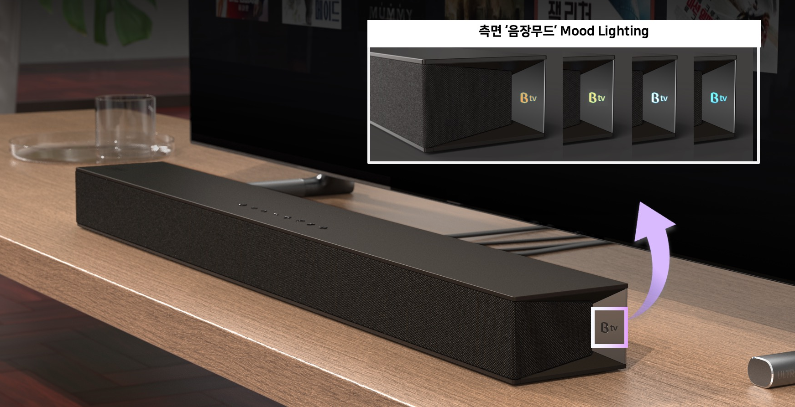
[Reference] Expected image

Slide 28
4.2 Sound Field Mod LED – Color Transition
Sound field mode LED is implemented with the representative color of the currently set sound field mode.
  When sound field mode is Off, sound field mode LED is off
  When sound field mode is on, Default standard mode (Standard) <Sound field mode LED: White> on
  <Sound field mode LED: White> on if it is set to standard mode (News)
  <Sound field mode LED: Cyan> on if it is set to News mode
  <Sound field mode LED: Yellow> on if it is set to Music mode
  <Sound field mode LED: Orange> on if it is set to Movie mode
  <Sound field mode LED: Pink> on if it is set to Auto mode
The sound field mode LED changes the color of the sound field mode LED when the sub sound field mode is changed, and when the setting is changed, the color transition changes to a color dissolve method for 0.7 seconds.(For natural color change, the time will be decided after the test, and whether to add it in the middle of the black color is also decided after 1/8 test, see the next chapter.).
  Sound field mode change via set-top box sound field mode button
  Change the sound field mode via the remote control [shortcut] button
  Sound field mode change through sound field mode screen UI
However, if the mapped sub mode continues to change, such as real-time TV> channel zapping or quick mode change through the remote control in the set state, the LED color of the corresponding mode is switched to the corresponding mode's LED color when maintaining a specific sub mode for 2 seconds(Time to be determined after testing for natural color change).
Current Sound Field
State color
→ Hold the mode for 2 seconds →
Changed sound field mode
State color

Slide 29
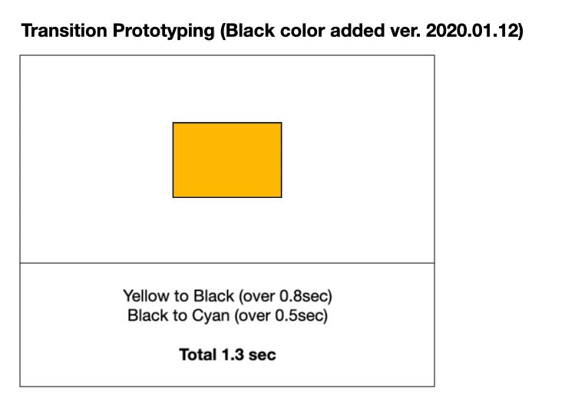
[참고] Color Transition Reference (example video attached)

Slide 30
Thank you

