Slide 1
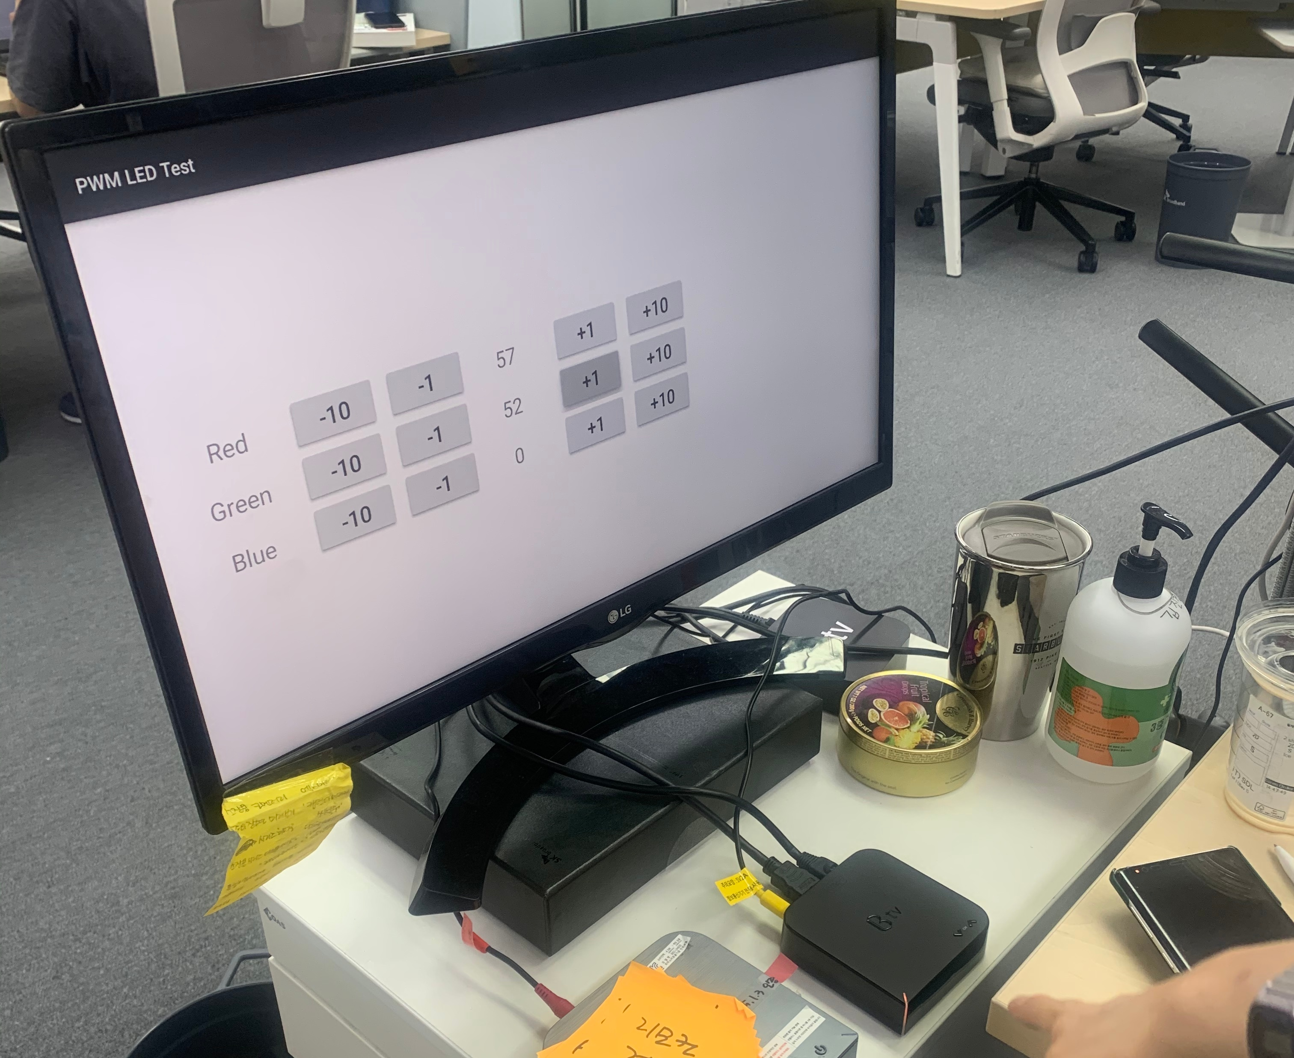
① ② ③ ④ ⑤
Red
-10
-1
57
+1
+10
Green
-10
-1
52
+1
+10
Blue
-10
-1
0
+1
+10
① The value will decrease 10 when user press this button.
② The value will decrease 1 when user press this button.
③ RGB value will show when user press ①, ②, ④, ⑤ button.
④ The value will increase 1 when user press this button.
⑤ The value will increase 10 when user press this button.

