Slide 1
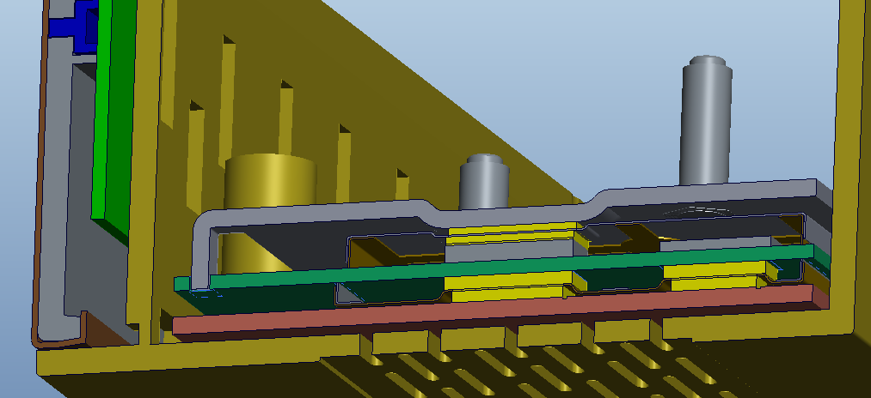
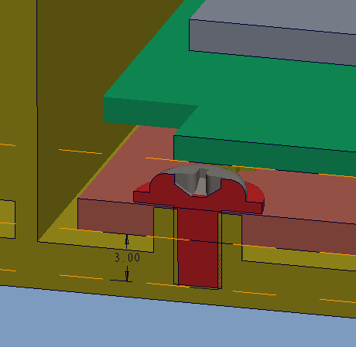
Limited space to create the boss for ABS resins.

Slide 2
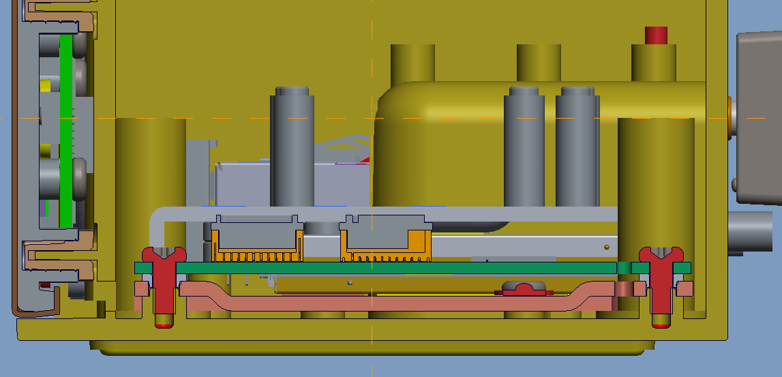
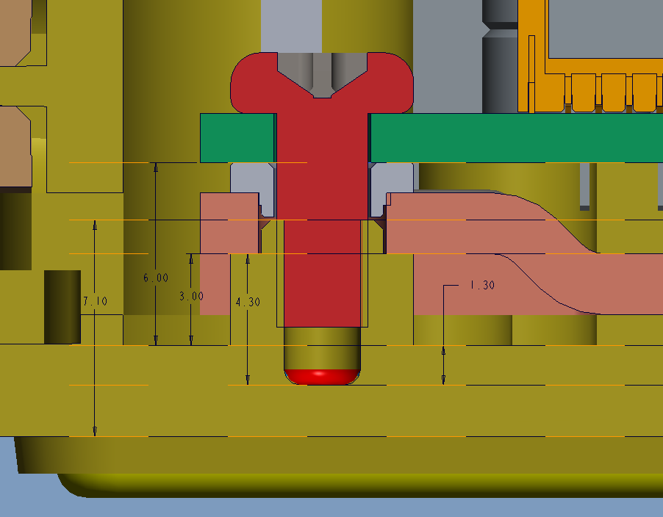
Suggest to modify the boss design like this:
5.3

Slide 3
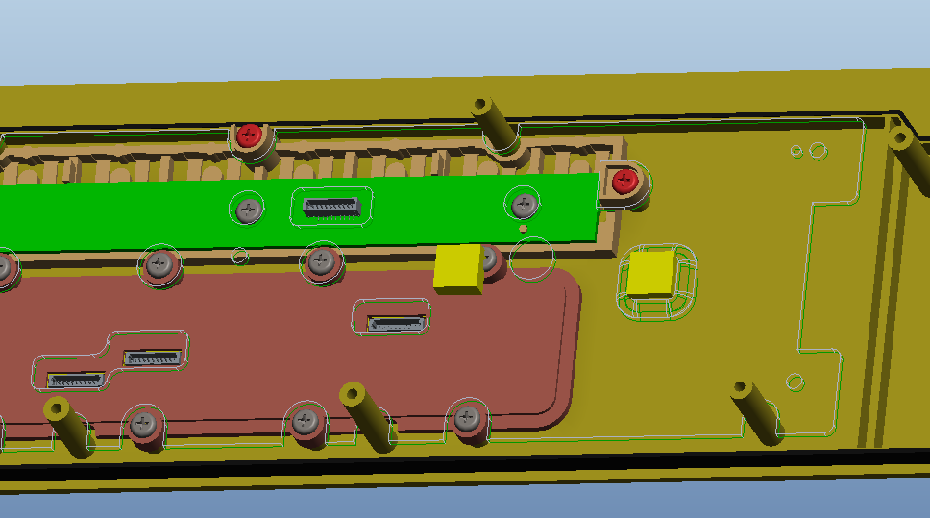
Could the boss feature can be move away and be loated in this position?
Thermal pad here

