Slide 1
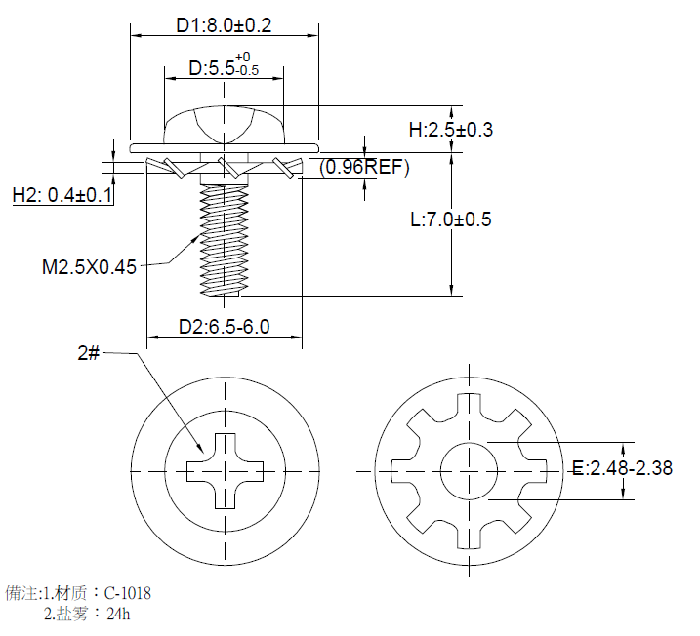
M2.5*7mm spec:
Material : carbon steel C-1018
Finish:Black ZN coating
Salt spray test:24H

Slide 2
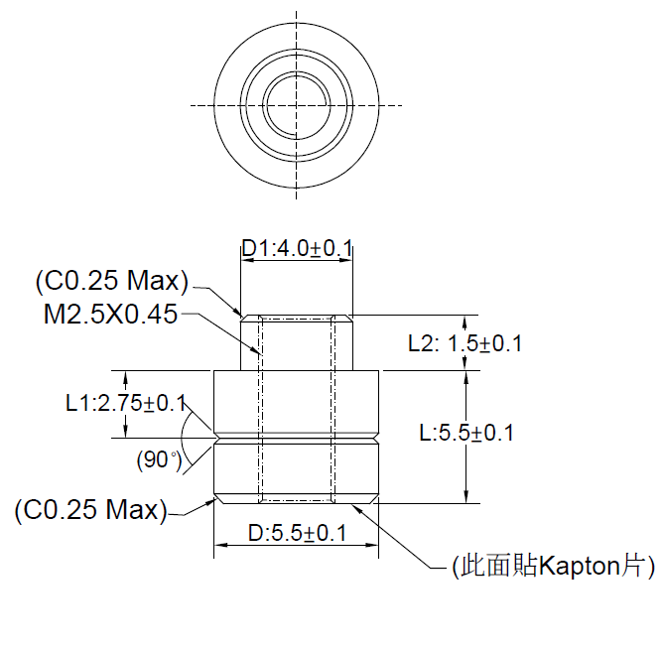
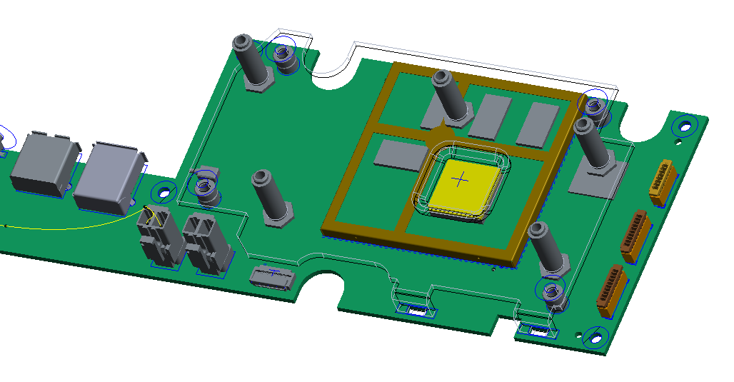
M2.5*7mm Screw to fix the heat spreader of soc top(4pcs)
Will apply Mechanical_thread_M2.5x0.45 screw.
Screw nut spec

Slide 3
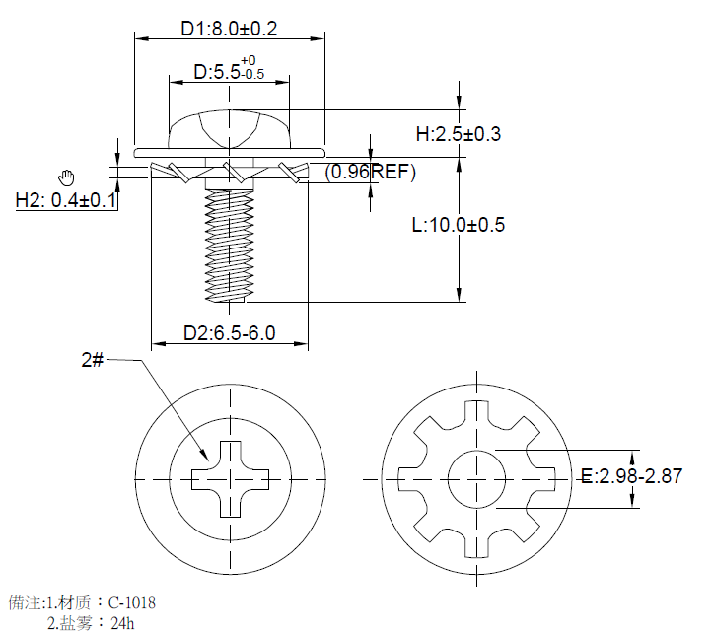
M3*10mm spec :
Material : carbon steel C-1018
Finish:Black ZN coating
Salt spray test:24H

Slide 4
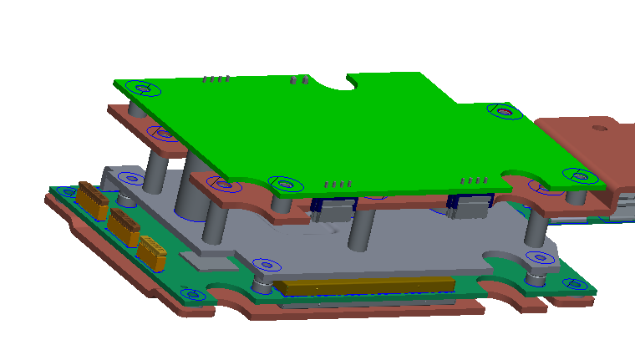
Will apply M3*10mm screw(4pcs) to fix the AMP board

Slide 5
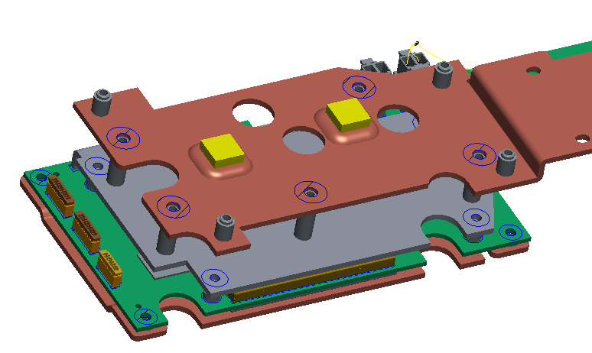
Will apply M3*10mm screw(5pcs) to fix the heatsperader AMP bottom

