Slide 1
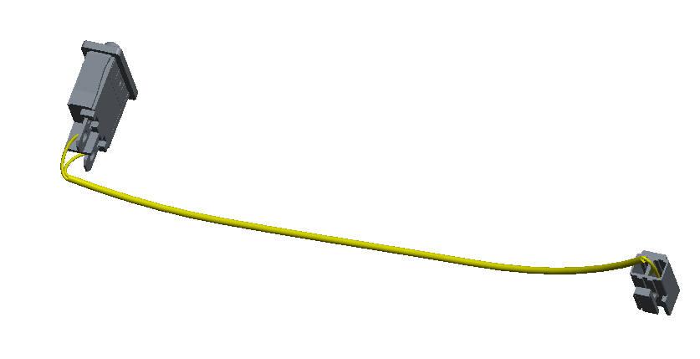
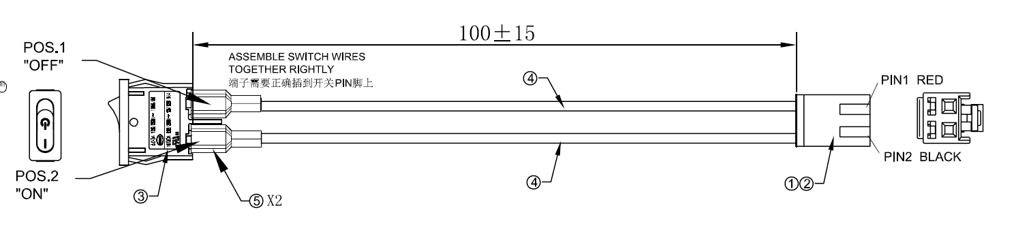
Power switch cable spec
2 pin header

Slide 2
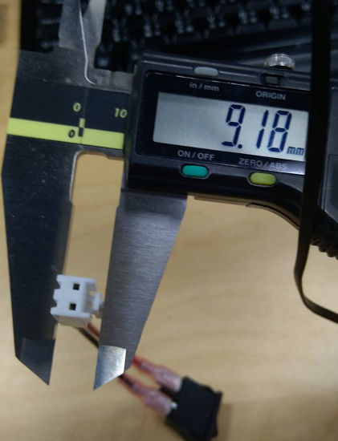
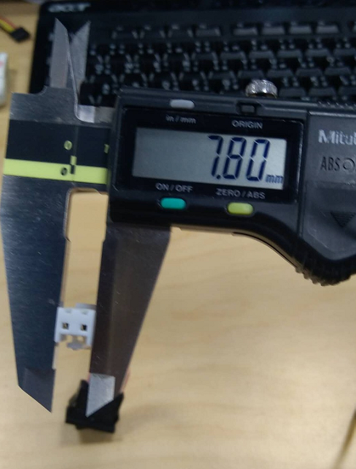
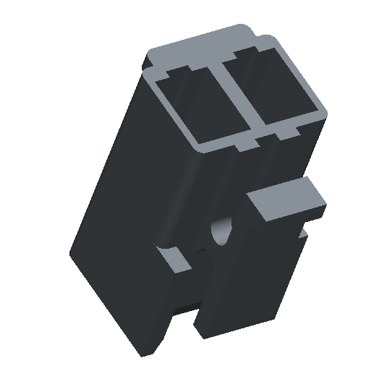
7.8mm
9.18mm
2 pin header

Slide 3
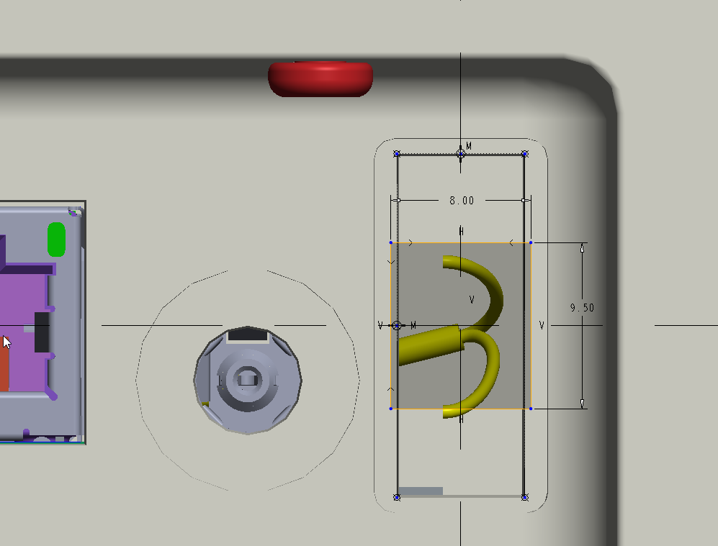
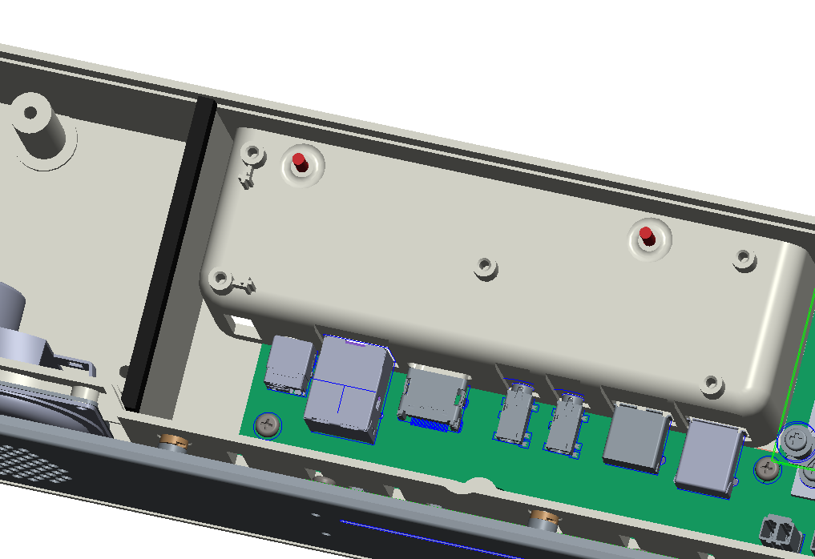
2 pin header need to go through the opening hole first before mounting the power switch onto housing.
Suggest to make a cutout on opening hole of bottom case to prevent assembly issue.

