Slide 1

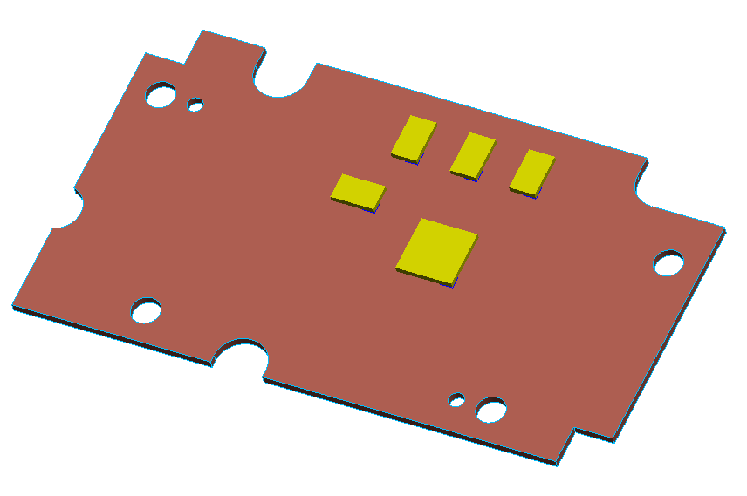
Heat spreader Soc bottom
Inkel design
Foxconn design
This part is updated and totally fix the design of inkel.

Slide 2
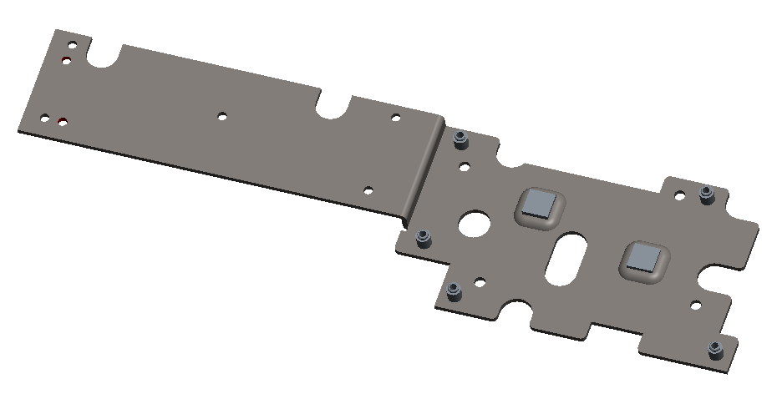
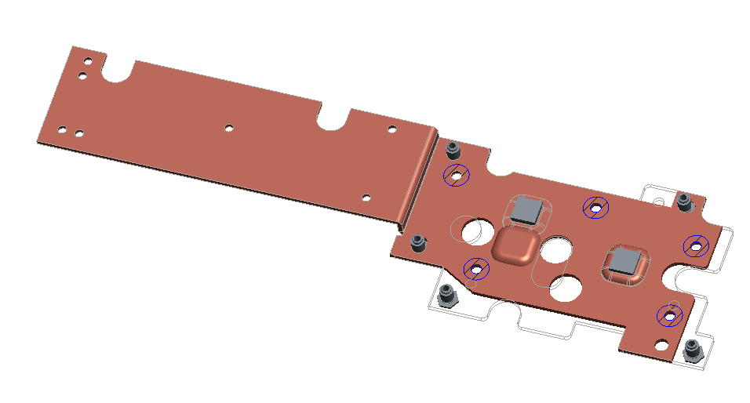
Heat spreader AMP bottom
Inkel design
Foxconn design(red-brown color)
Feature in this area is updated and totally fix the design of inkel.
Design on this area were updated to fix layout request.

Slide 3
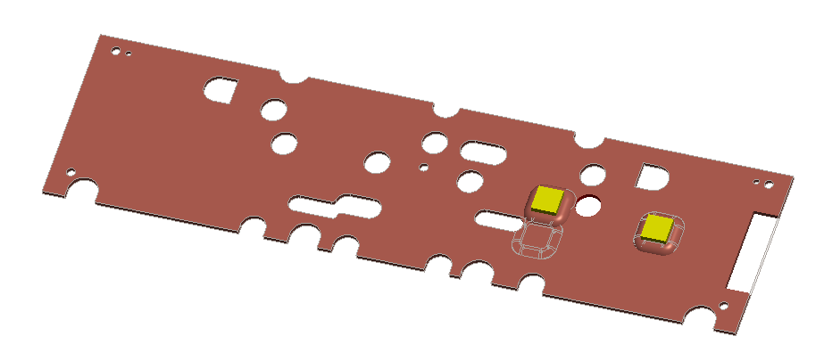
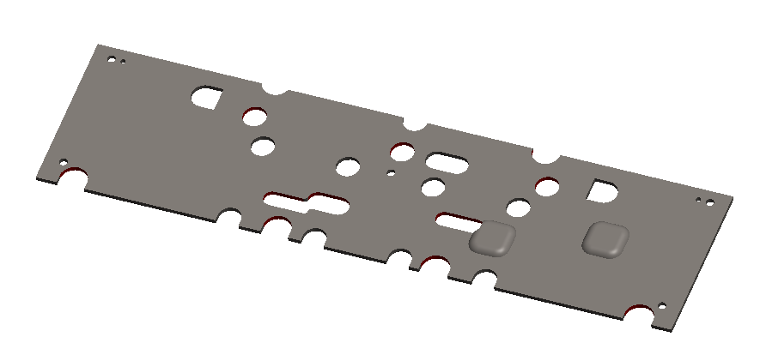
Heat spreader AMP Top
Inkel design
Foxconn design(red-brown color)
1.New position of thermal pad per latest layout
This part was updated per inkel’s design, but some items need to be updated.
2.Need to make a cutout for cable routing

Slide 4
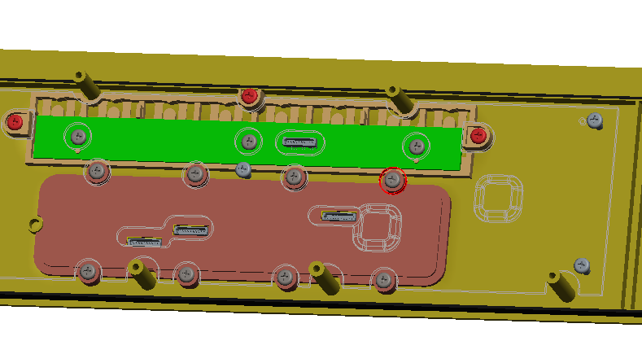
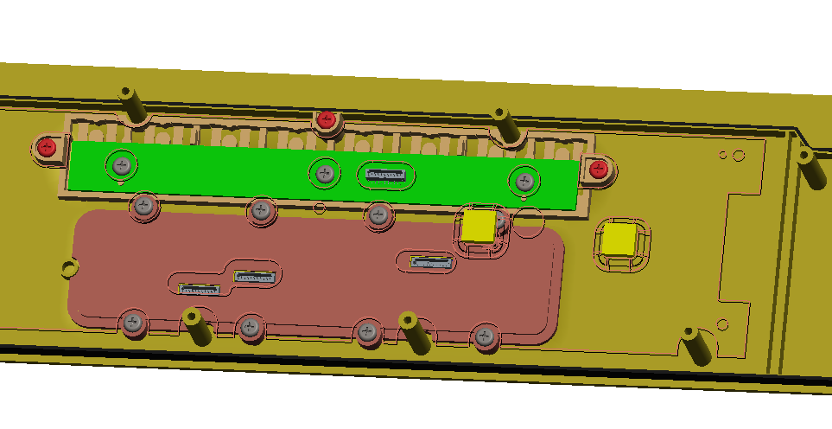
Heat spreader AMP Top
Inkel design
Foxconn design(red-brown color)
3.This hole/screw suggest to move to this pisition to prevent interference with punch feature.

