Slide 1
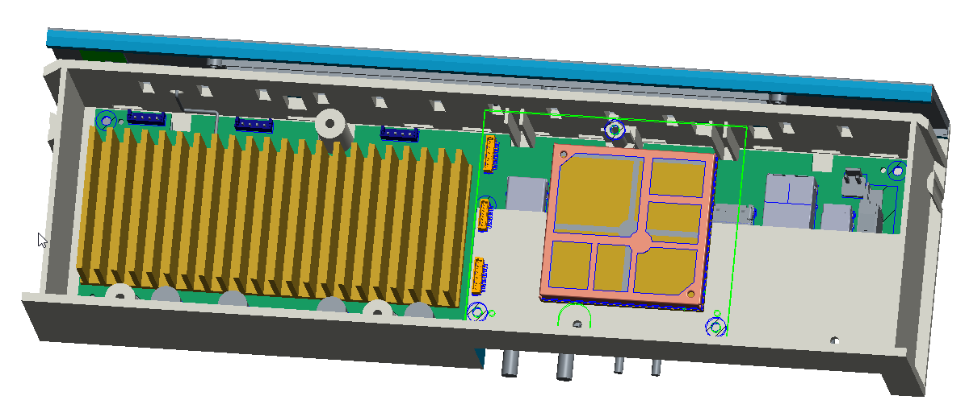
Proposal of Soc_board
By 2020-07-27
Screw boss design to fix the soc_board, detail see the 3D file
Add ribs to support Soc_board

Slide 2
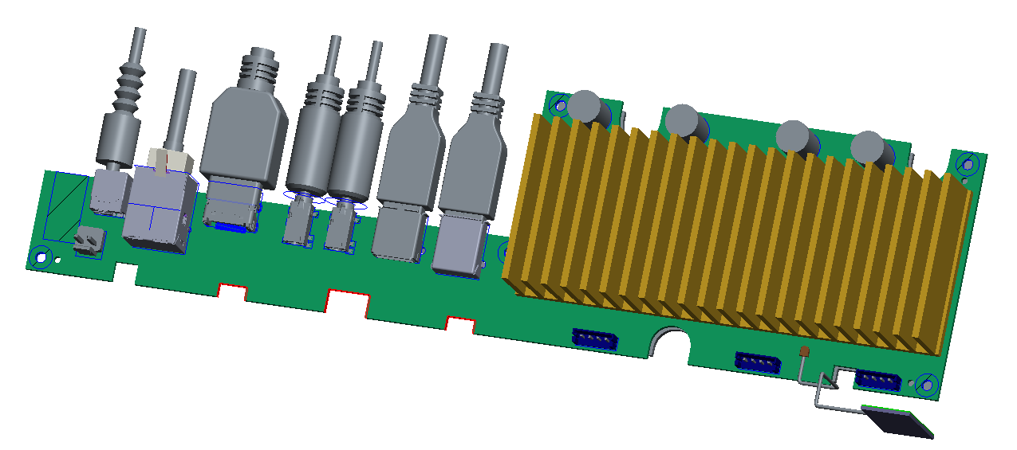
Proposal of main_board
Accordingly, will beed to have cutout feature on main board.

