Slide 1
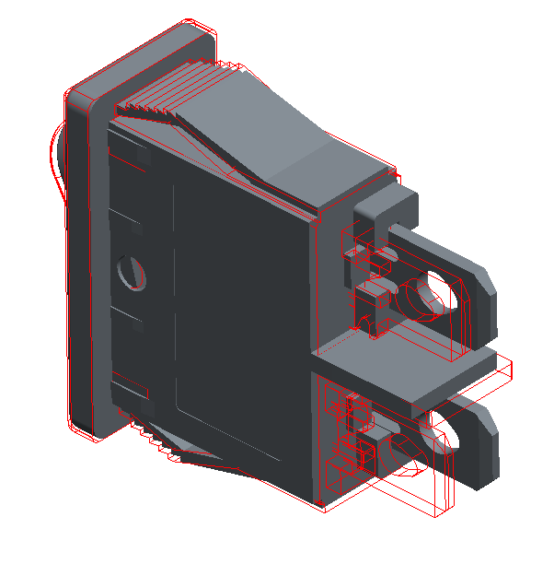
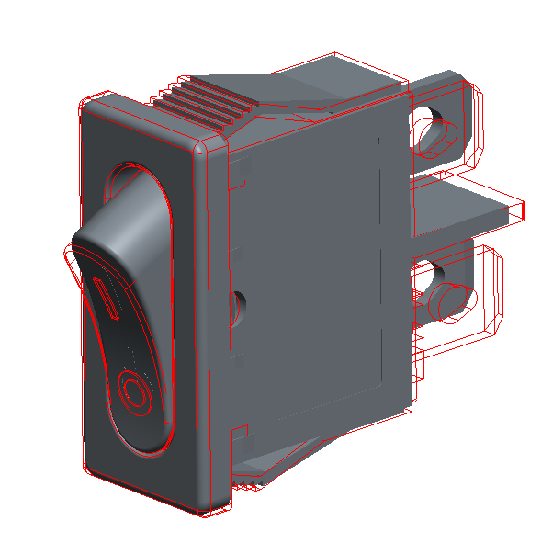
Cable power switch updated by 2020-08-24
Latest Powerswitch( in red color lines)

Slide 2
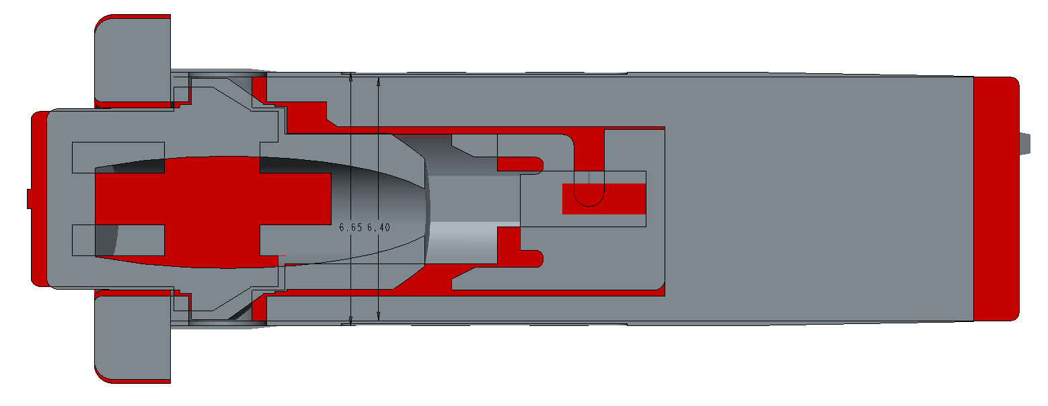
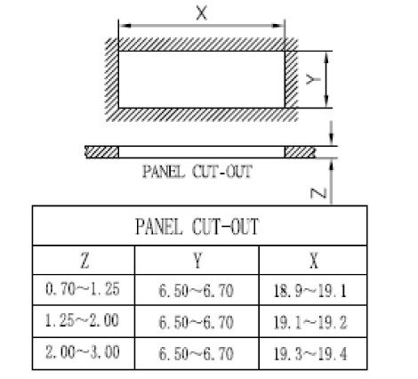
Latest Powerswitch(w=6.40mm)
Cutout spec on panel pls refer to the attached 2D drawing:
Previous Powerswitch(w=6.65mm)

