Slide 1
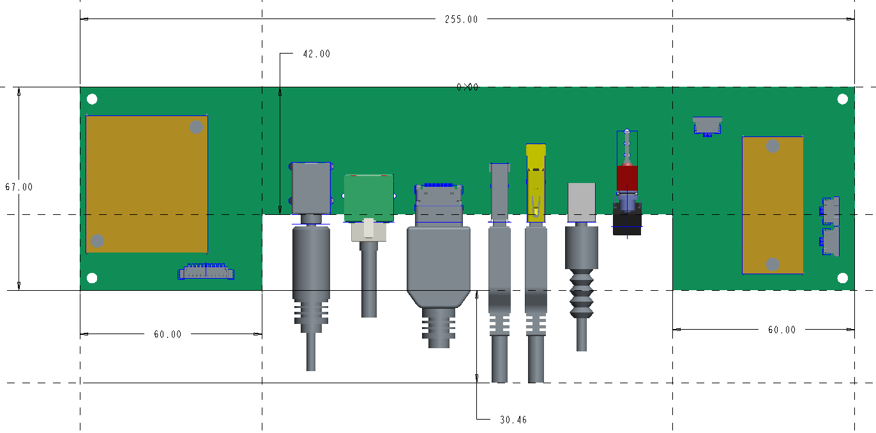
Updated PCB outlet design:
L255*W67mm
135.00

Slide 2
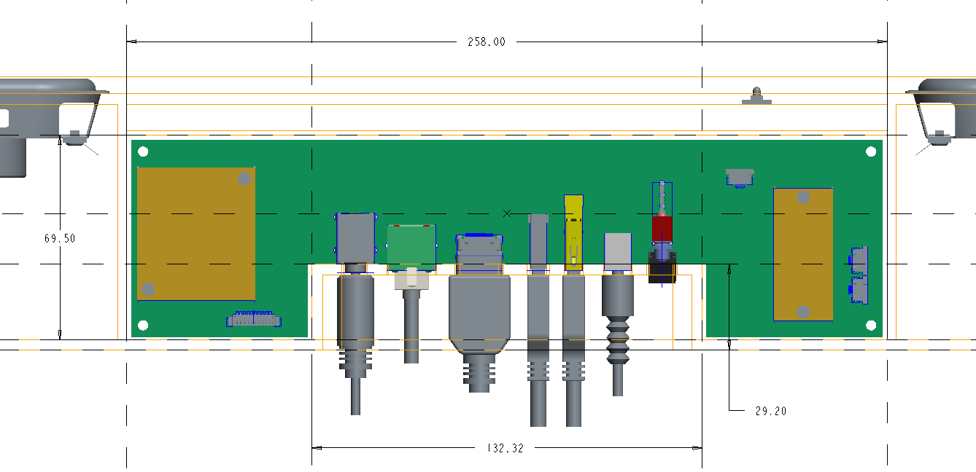
Updated PCB cabinet outlet :
L258*W69.50mm
Back-panel dimension：L132.32*W29.20mm

Slide 3
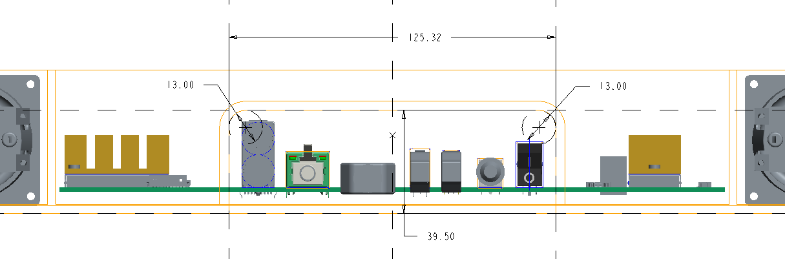
Back-panel dimension:
L125.32*H39.50*R=6.5mm

Slide 4
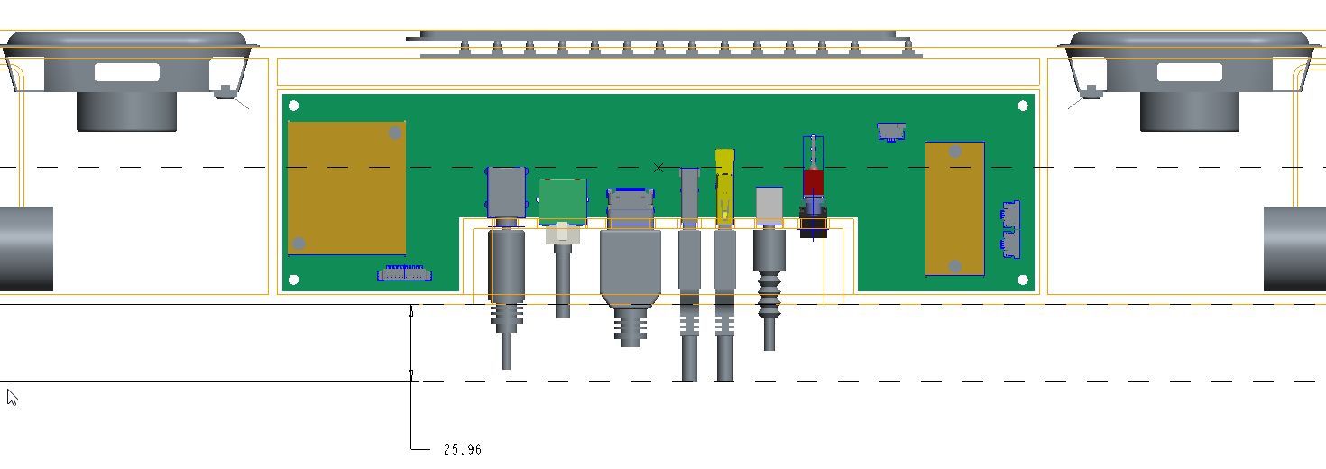
Considering the part thickness and be well of containing the plug-cable ends, recommend that the total thickness of wall mount at least should be >=30mm.

