Slide 1
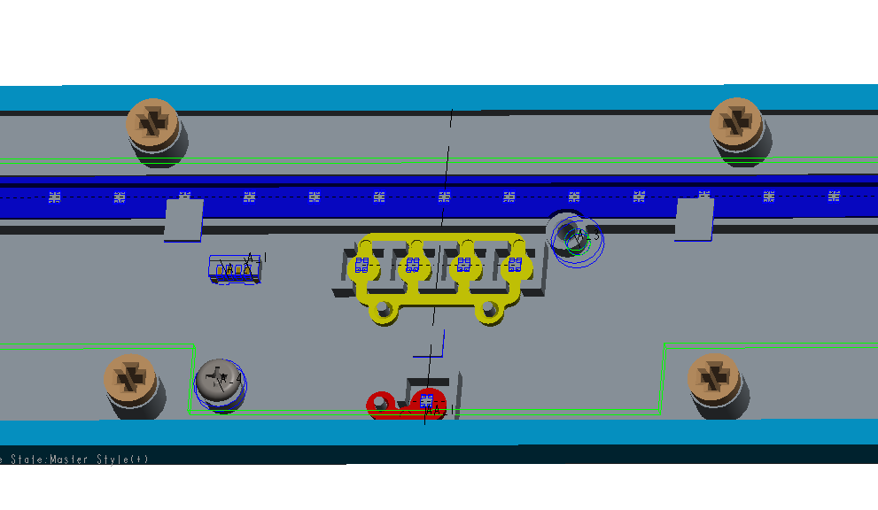
The boss do not fix the screw opening of LED board, pls revise it according to the latest LED board data.
ALT ] confirmed 13 pcs mockup except 4 pcs.
4 of mockup is in progress due to SKT Mic tuning schedule.

Slide 2
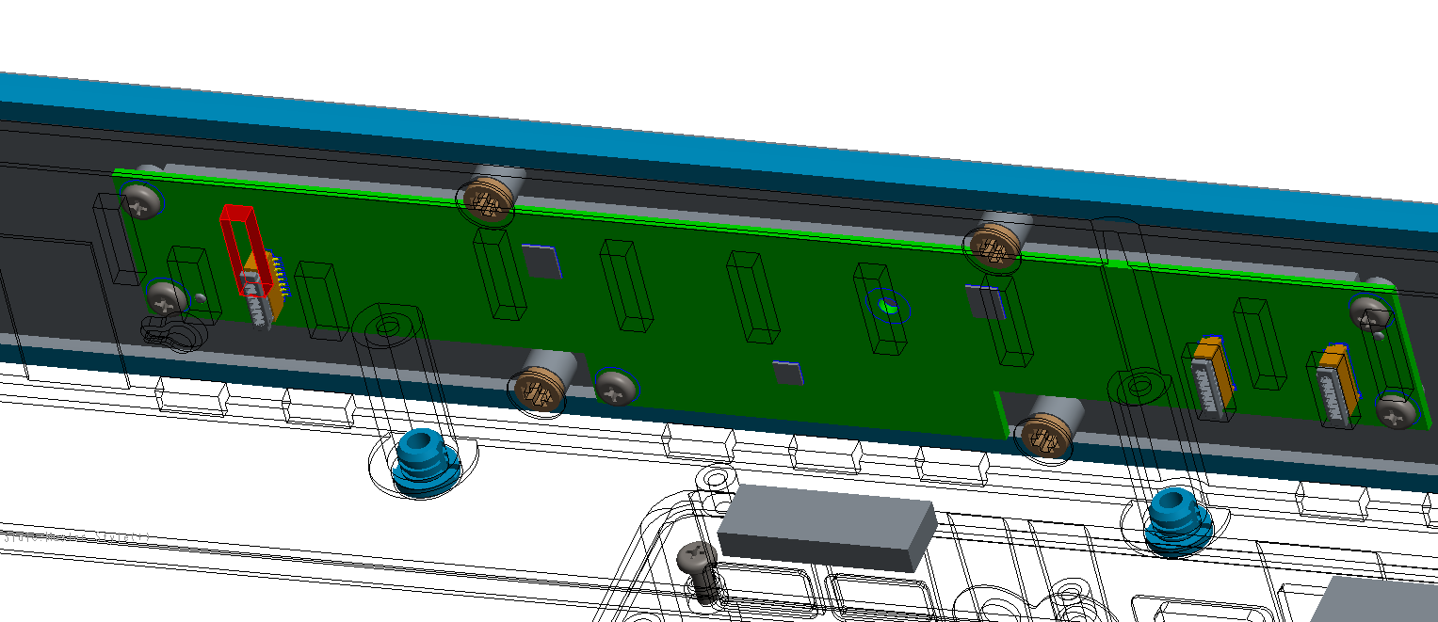
Do not align well here , pls revise the opening of bottom case according to the latest LED board data.
Ok
ALT ] confirmed 17 pcs mockup

Slide 3
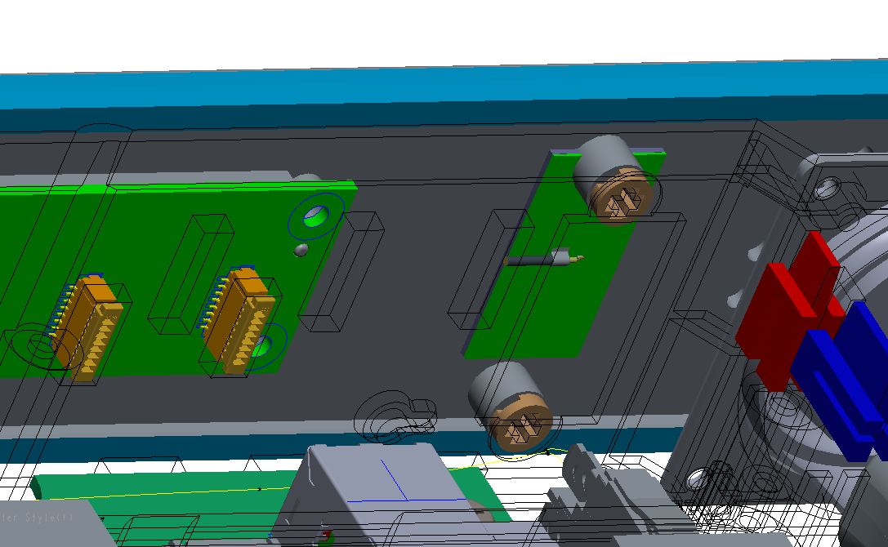
ANT PCB interfere with the boss, pls move away the boss feature.
ALT ] confirmed 16 pcs mockup except 1 pcs.
1 of mockup is in progress due to SKT Mic tuning schedule

Slide 4
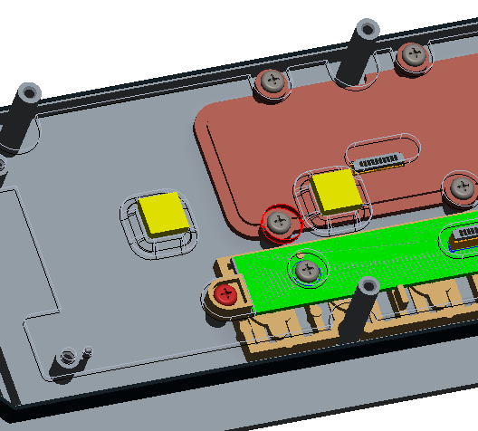
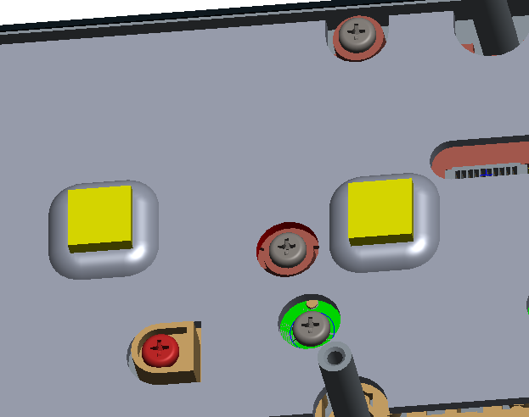
Interfere with the boss, I revised the heat spreader AMP top already as right picture.
ALT ] confirmed FXN suggestion.
Before modify
After modify

Slide 5
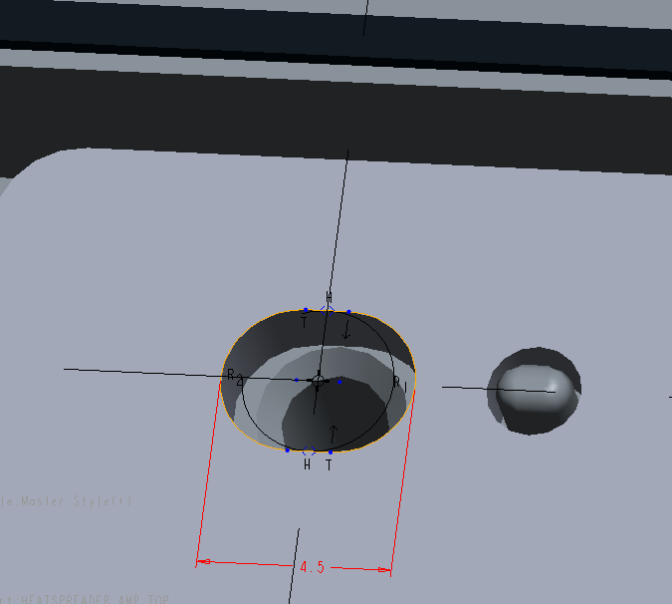
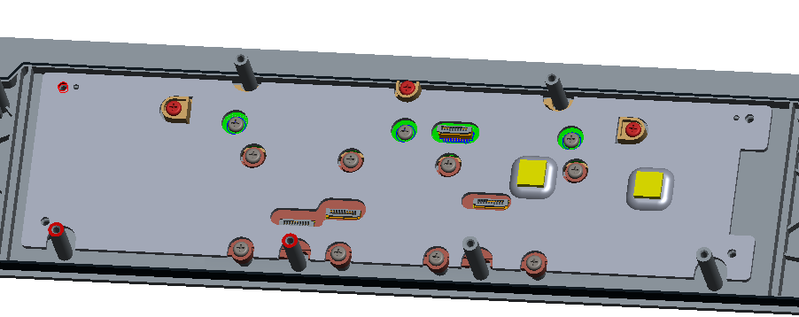
Suggest to modified the circular hole to be L4.5*w3.5mm considering the impact of tolerance on x-direction. I already modify it as attached data.
Before modify
After modify
ALT ] confirmed FXN suggestion.

Slide 6
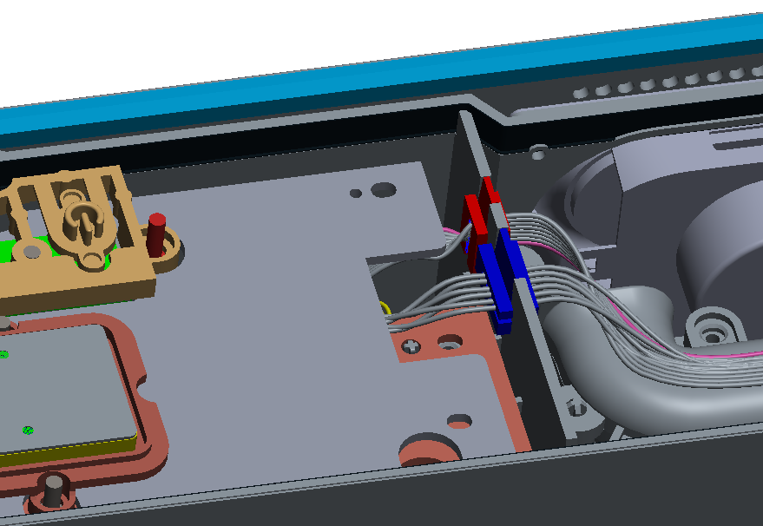
Suggest to make a cutout on this heat spreader for cable routing, in order to prevent cables are scratched or damaged.
ALT ] confirmed FXN suggestion.

Slide 7
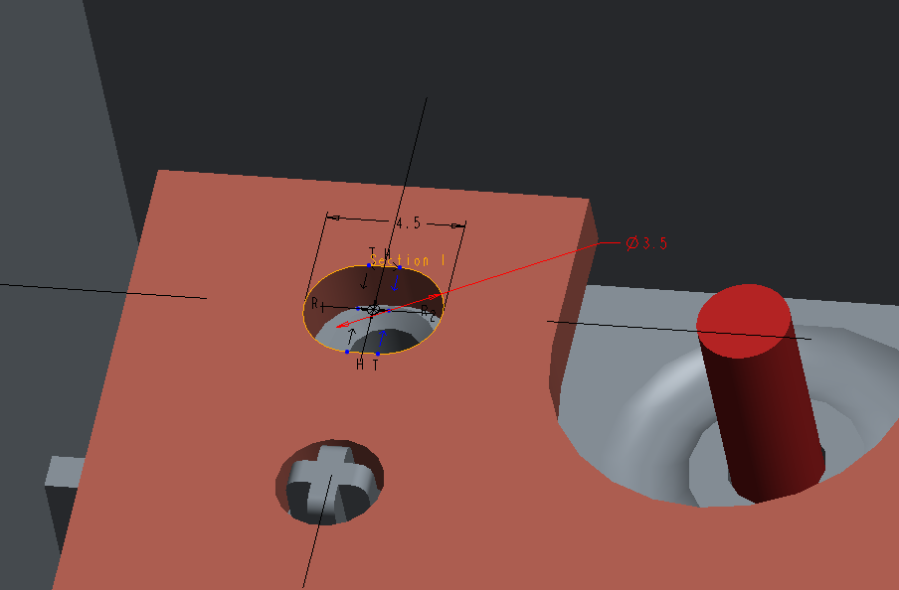
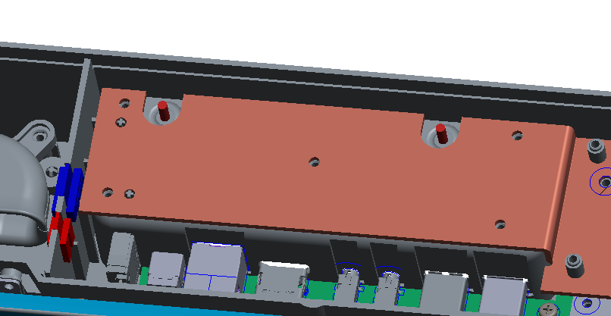
Suggest to modified the circular hole to be L4.5*w3.5mm considering the impact of tolerance on x-direction. I already modify it as attached data.
Before modify
After modify
ALT ] confirmed FXN suggestion.

Slide 8
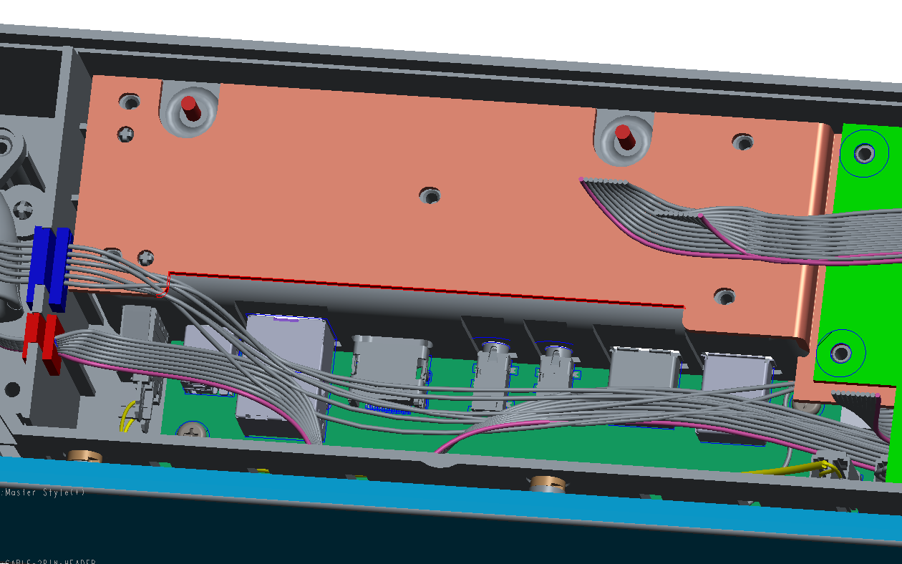
Suggest to make a cutout on this heat spreader of AMP bottom for cabling routing easily.
ALT ] confirmed FXN suggestion.

Slide 9
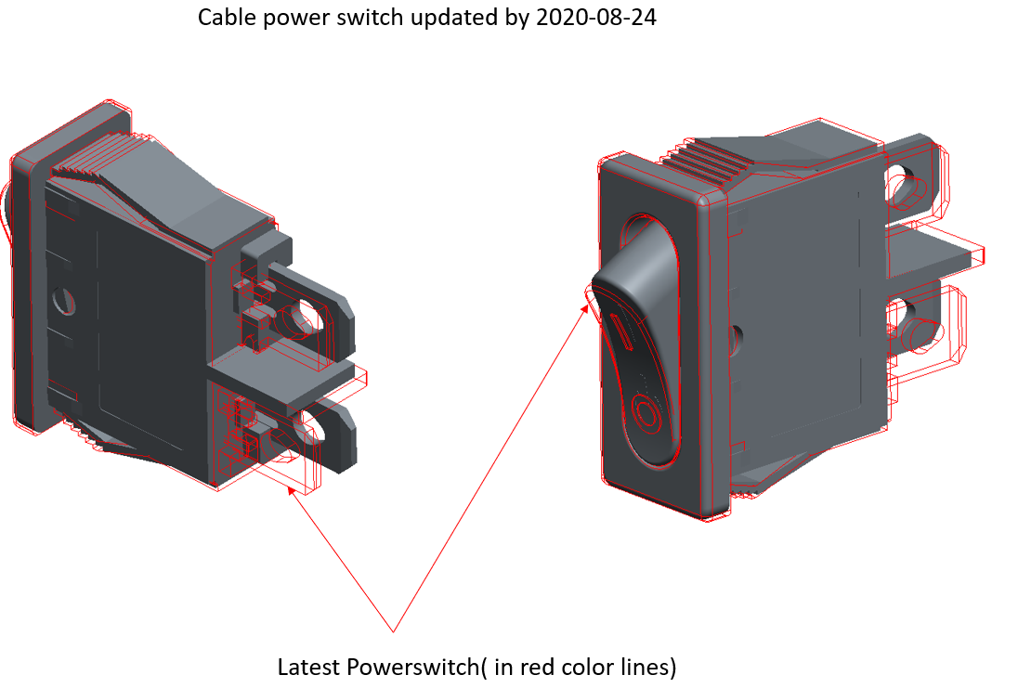
(ME) Daniel Hu
2020-08-24 09:16developer ~0004114
ALT ] confirmed power switch updated.
and 16 pcs mockup except 1 pcs.
1 of mockup is in progress due to SKT Mic tuning schedule.
And 3d modeling data is updated as power switch vender recommend cut out.

