Slide 1
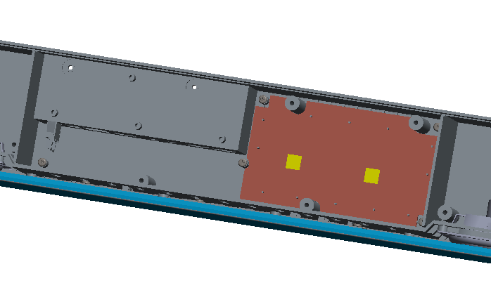
Soc_board_bottom_spreader
1.Soc_board_bottom_spreader will be fixed on the bottom case by heat staking process.

Slide 2
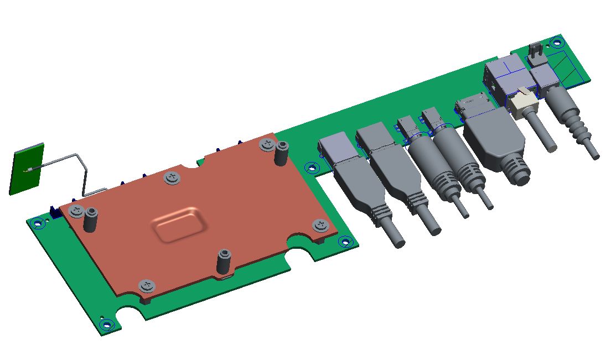
Soc_board_top_spreader
2.Soc_board_top_spreader will be fixed on soc_board per stand-off.

Slide 3
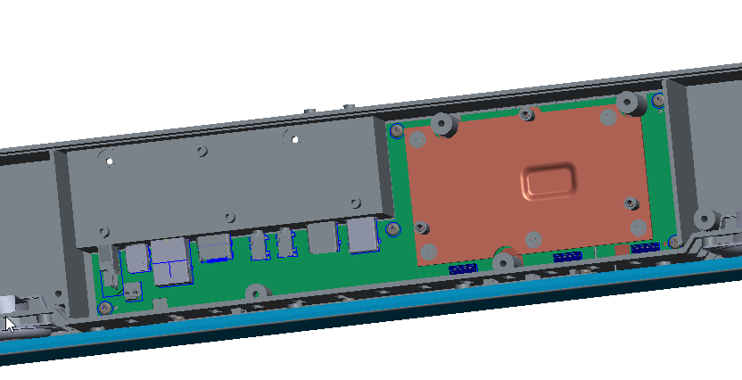
Soc_board
3. Place soc_board on bottom case and fix it well.

Slide 4
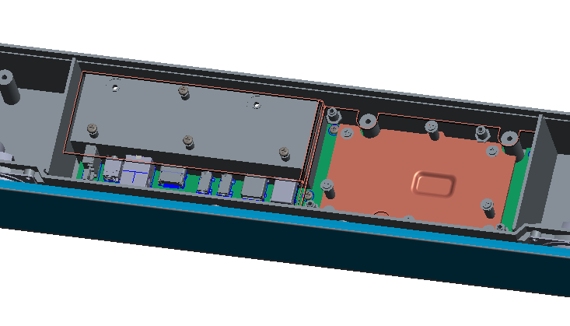
AMP_board_bottom_spreader
4. Fix the bottom_heat-spreader of AMP_board onto the bottom case.

Slide 5
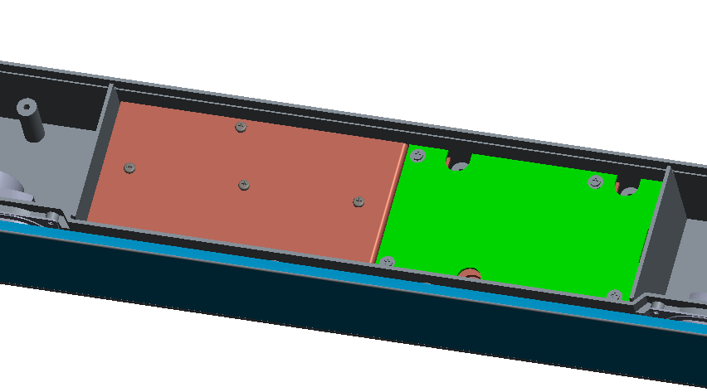
AMP_board
5. Fix the AMP_board onto bottom_heat-spreader of AMP_board

Slide 6
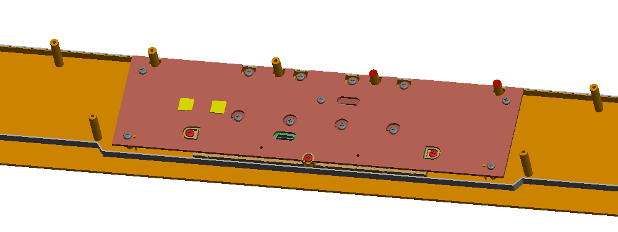
AMP_board_top_spreader
6. The top-heat-spreader of AMP_board will be assembled onto top case.

