Slide 1
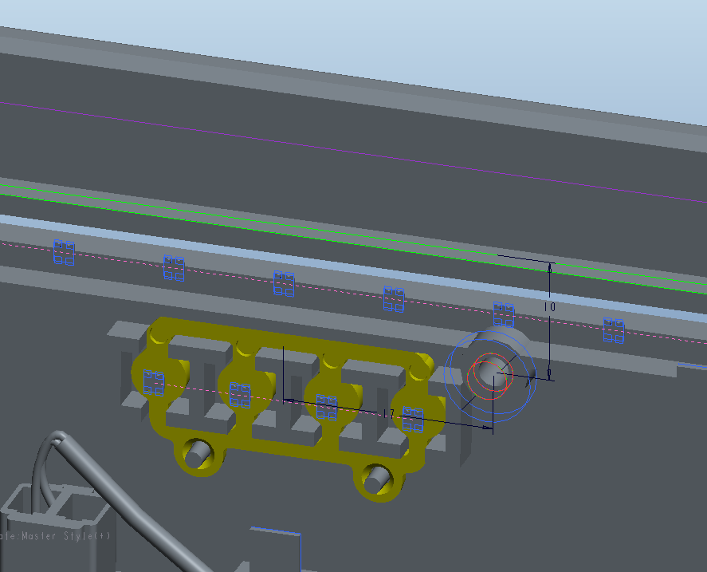
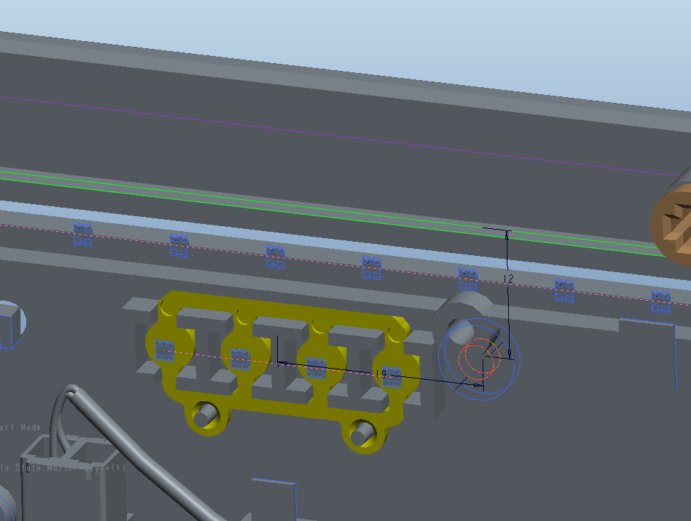
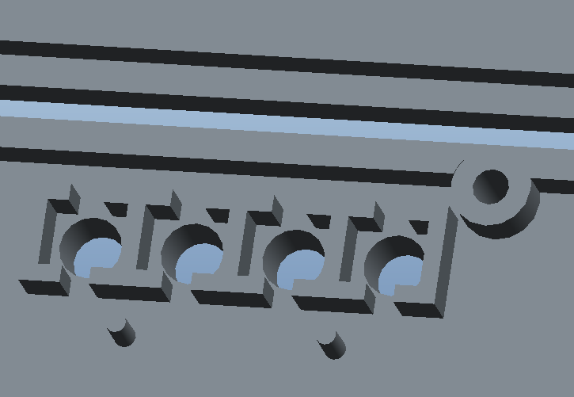
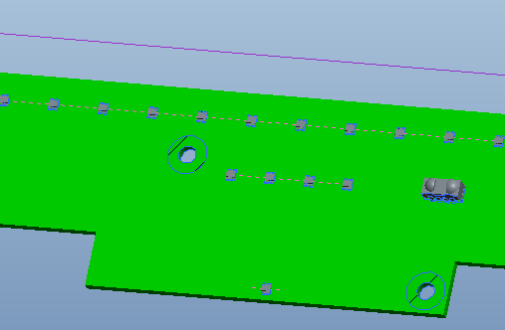
The boss was settle up too close to LED-IC, we need to move 2.00mm away. Pls review and updated the

Slide 2
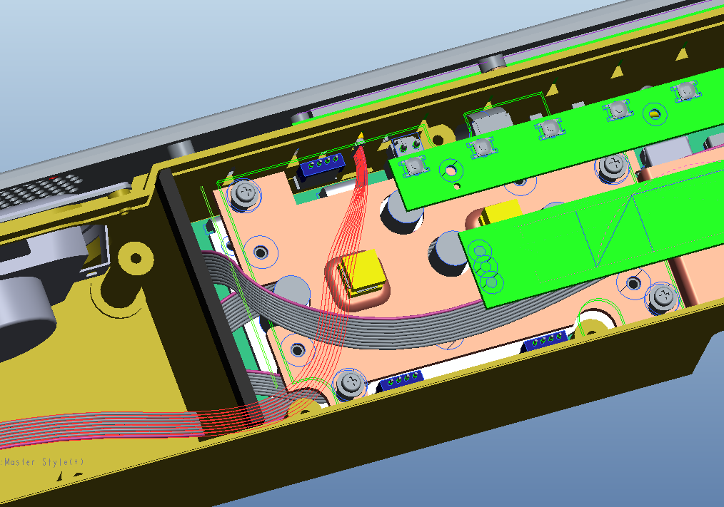
New position of connector to right side LED board, in order to avoid interference with 2 pin header
2 pin header

