Slide 1
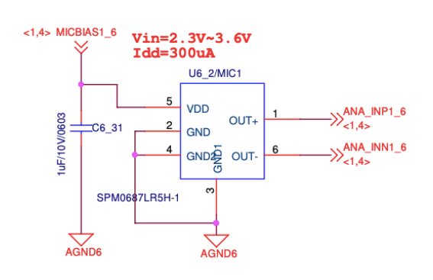
TP
TP
4 MIC need to each TPs

Slide 2
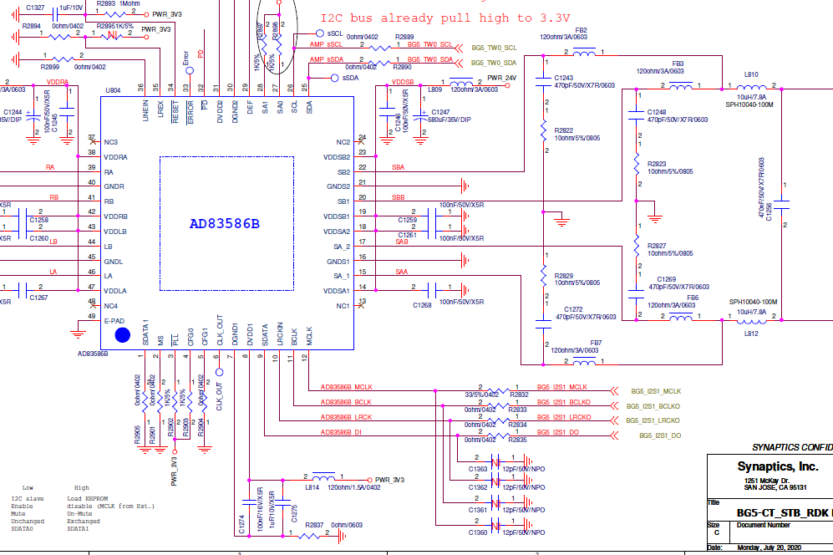
TP(Amp B/D) Near by connector

