Slide 1
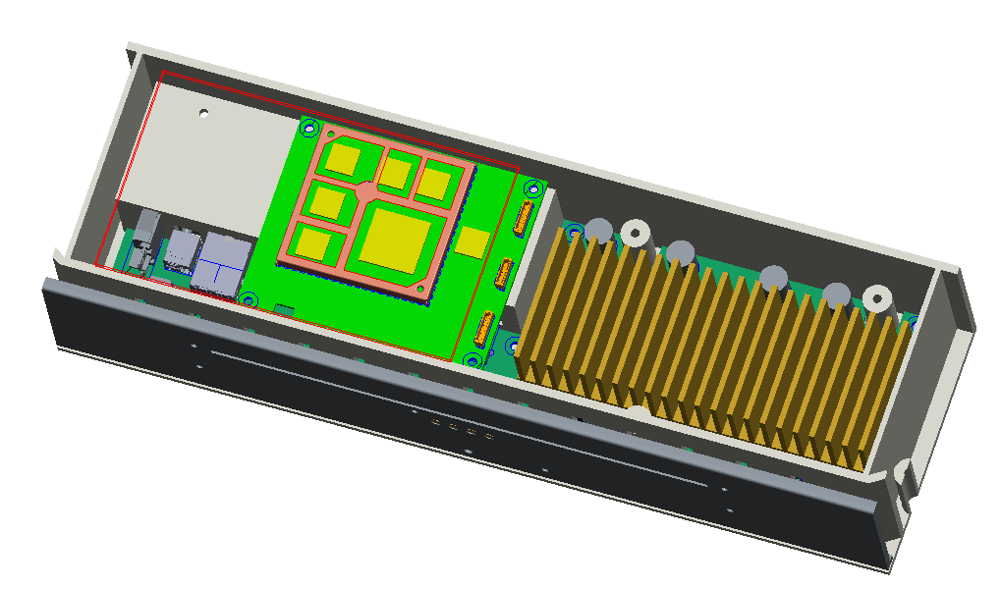
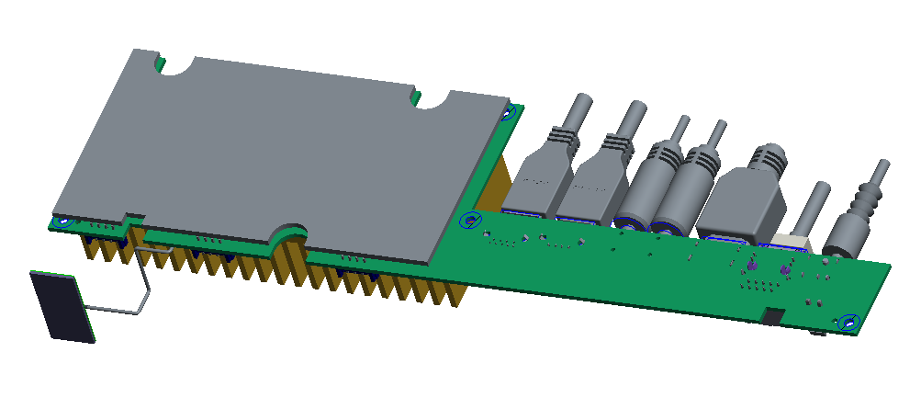
AMP_board + Soc_board design proposal
Updated by 2020-7-24
Soc_board_Heatspreader
Soc_board
AMP_board
AMP_board_Heatspreader-bottom
AMP_board_Heatsink-top

Slide 2
